Slide 1
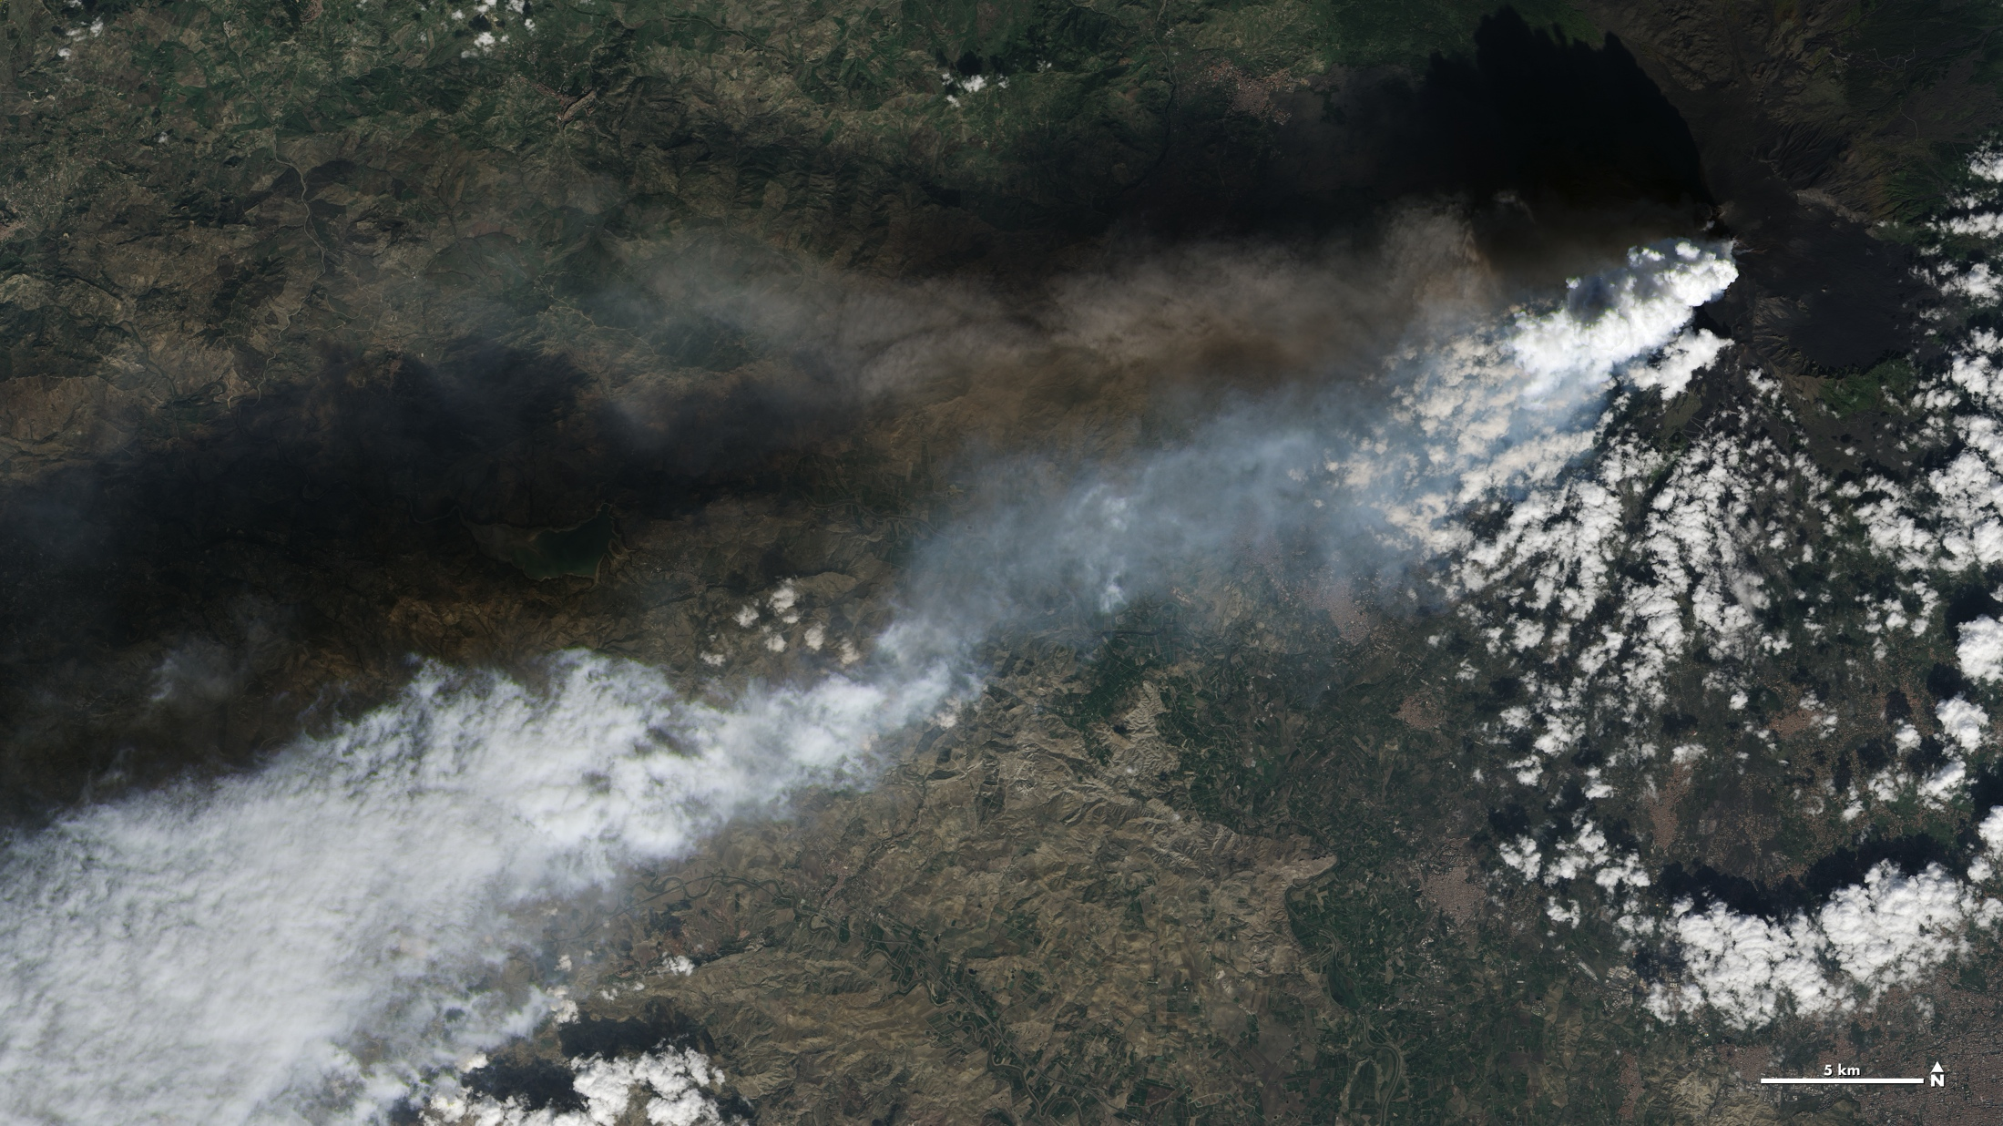
Notes:
Mount Etna
Twin volcanic plumes—one of ash, one of gas—rose from Mount Etna in Sicily, Italy on the morning of October 26, 2013. The National Institute of Geophysics and Volcanology Etna Observatory reported that Etna was experiencing its first eruption in six months. Multiple eruption columns are common at Etna, a result of complex plumbing within the volcano. The Northeast Crater, one of several on Etna’s summit, was emitting the ash column, while the New Southeast Crater was simultaneously venting mostly gas.
This natural-color image collected by Landsat 8 shows the view from space at 11:38 AM, local time. The towering, gas-rich plume cast a dark shadow over the lower, ash-rich plume and Etna’s northwestern flank. Relatively fresh lava flows (less than a century or so old) are dark gray; vegetation is green; and the tile-roofed buildings of Bronte and Biancavilla lend the towns an ochre hue.
Satellite: LandSat 8
Instrument: OLI

