Slide 1
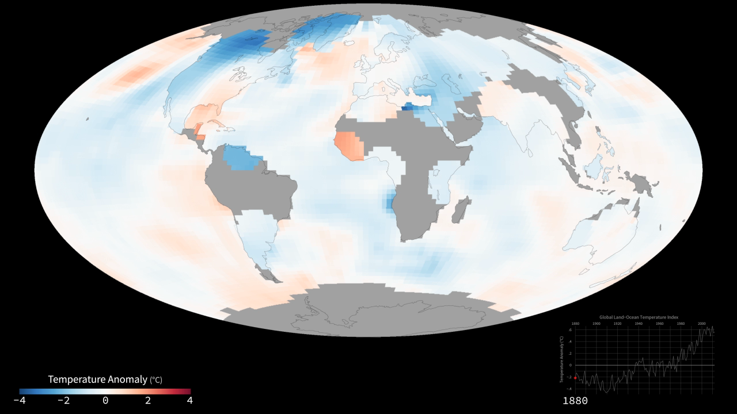
Notes:
The world is getting warmer. This map shows global, annual temperature anomalies from 1880 to 2013 based on analysis conducted by NASA’s Goddard Institute for Space Studies (GISS). Red and blue shades show how much warmer or cooler a given area was compared to an averaged base period from 1951 to 1980. The graph shows yearly, global GISS temperature anomaly data from 1880 to 2012. Though there are minor variations from year to year, the general trend shows rapid warming in the past few decades, with the last decade being the warmest.
To conduct its analysis, GISS uses publicly available data from approximately 6300 meteorological stations around the world; ship-based and satellite observations of sea surface temperature; and Antarctic research station measurements. These three datasets are loaded into a computer analysis program that calculates trends in temperature anomalies relative to the annual average temperature from 1951 to 1980. Generally, warming is greater over land than over the oceans because water is slower to absorb and release heat. Warming may also differ substantially within specific landmasses and ocean basins.
Model: GISStemp analysis

