Slide 1
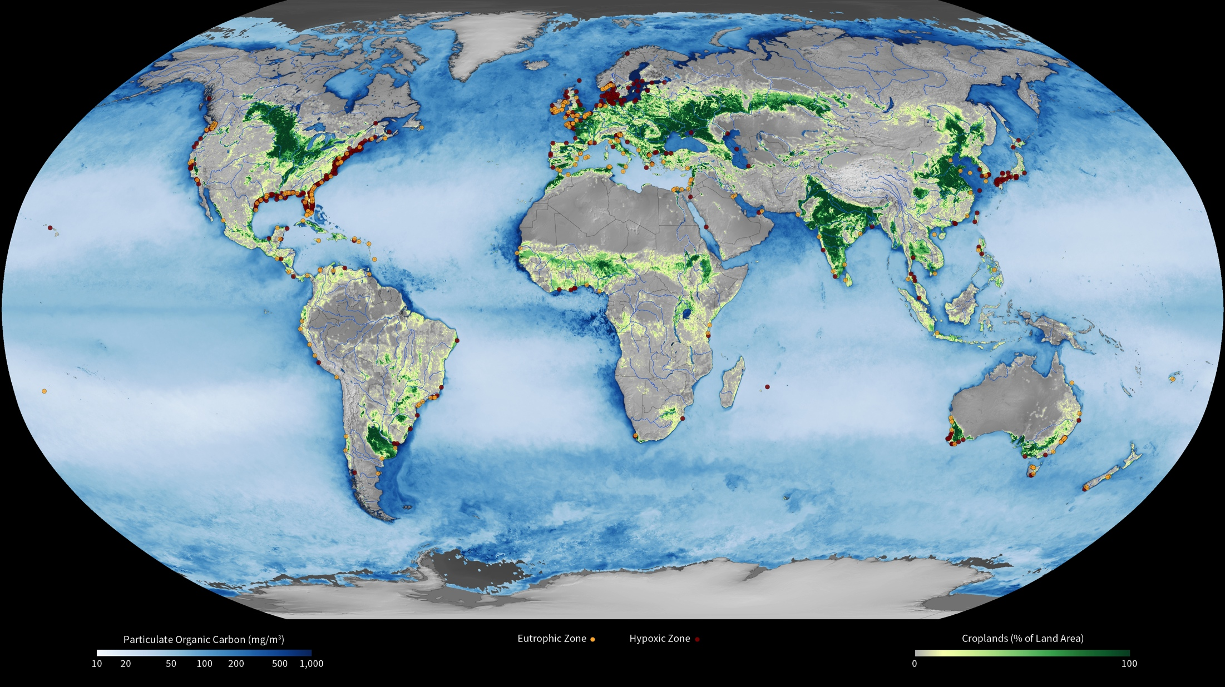
Notes:
Coastal Dead Zones
Marine hypoxic zones—or dead zones—are aquatic areas where the deep water is so low in dissolved oxygen that few sea creatures can survive. Dead zones result from a process called eutrophication, caused by too many nutrients (e.g., phosphorus and nitrogen) in the water. Human activities, such as the use of fertilizers for agriculture, are the main cause of these excess nutrients being washed into lakes, steams, rivers, and oceans. Fertilizer-laden runoff can trigger large blooms of planktonic algae. When the algae die, they trickle down into deep waters, where their remains are like fertilizer for microbes. The microbes decompose the organic matter and use up the oxygen in the water. As a result, large numbers of fish and other sea life die. In this map, data from the World Resources Institute show the location of reported eutrophic and hypoxic zones. Eutrophic zones—areas over-rich with nutrients—appear as yellow dots, while hypoxic zones appear as red dots. Green shades indicate the percent of land area used to grow crops derived from Moderate Resolution Imaging Spectroradiometer (MODIS) land-cover-type data. Blue shades indicate higher concentrations of particulate organic carbon (POC), an indication of the overly fertile waters that can culminate in dead zones. POC data are from the Ocean Color team at NASA’s Goddard Space Flight Center.

