Slide 1
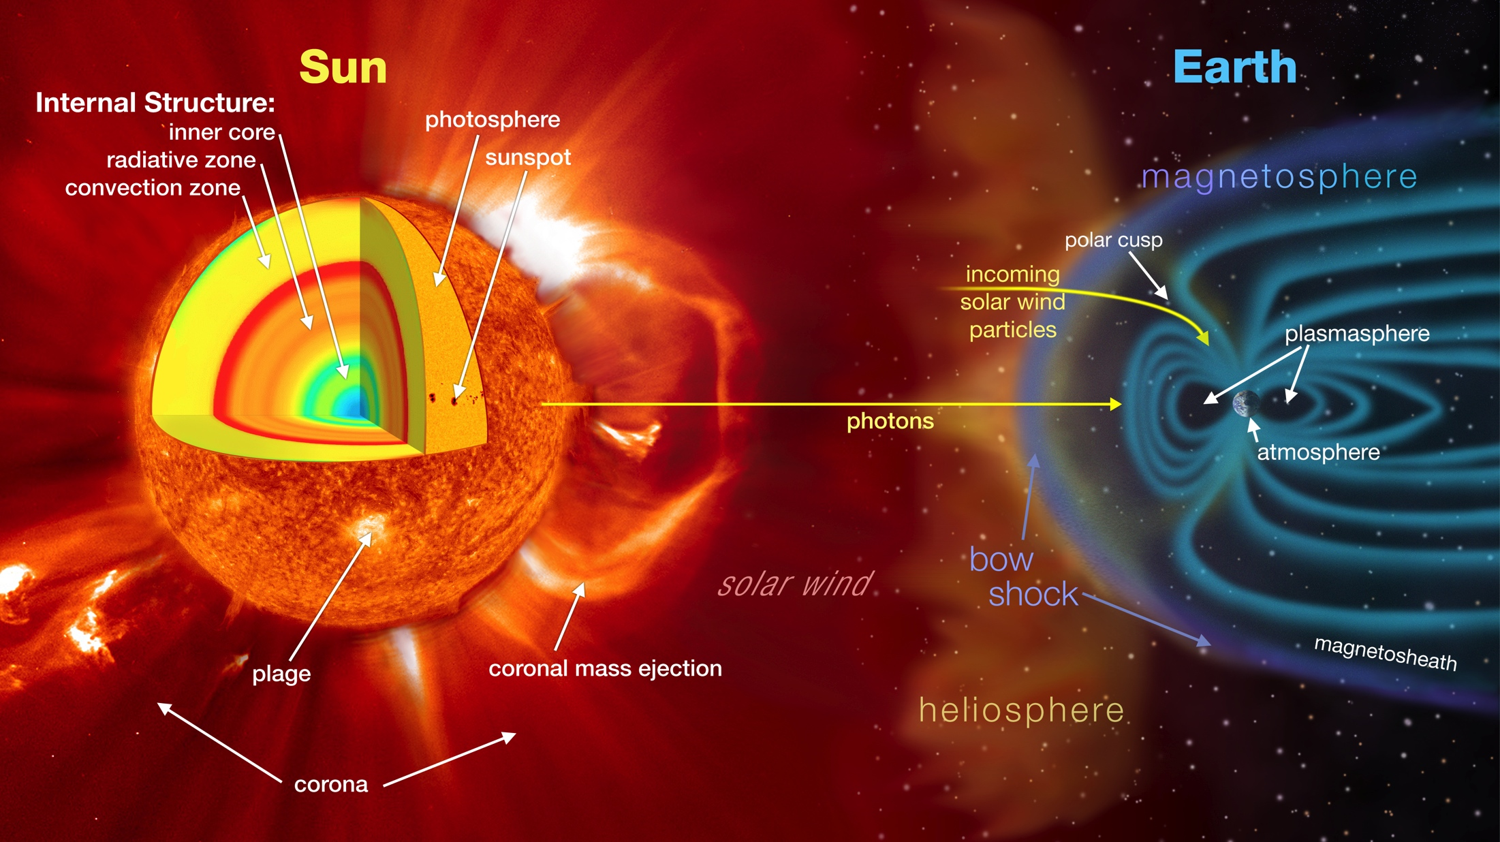
Notes:
The sun and its atmosphere consist of several zones, or layers, from the inner core to the outer corona. Beyond the corona is the solar wind, which is an outward expansion of coronal plasma that extends well beyond the orbit of Pluto. This entire region of space influenced by the sun is called the heliosphere. Controlled by the Earth’s magnetic field, the magnetosphere acts as a shield protecting the planet from solar wind. The shape of the Earth's magnetosphere is the direct result of being impacted by solar wind, compressed on its sunward side and elongated on the night-side, the magnetotail. The shock wave where the solar wind encounters Earth's magnetosphere is called the bow shock, which slows and diverts the solar wind.
Solar activity lead to solar eruptions, which includes such phenomena as sunspots, flares, prominences, and coronal mass ejections that influence space weather, or near-Earth environmental conditions. Modern society depends heavily on a variety of technologies that are susceptible to space weather. CMEs for example can cause geomagnetic storms that can disrupt satellite communications and navigational equipment, and even cause blackouts.

