Slide 1
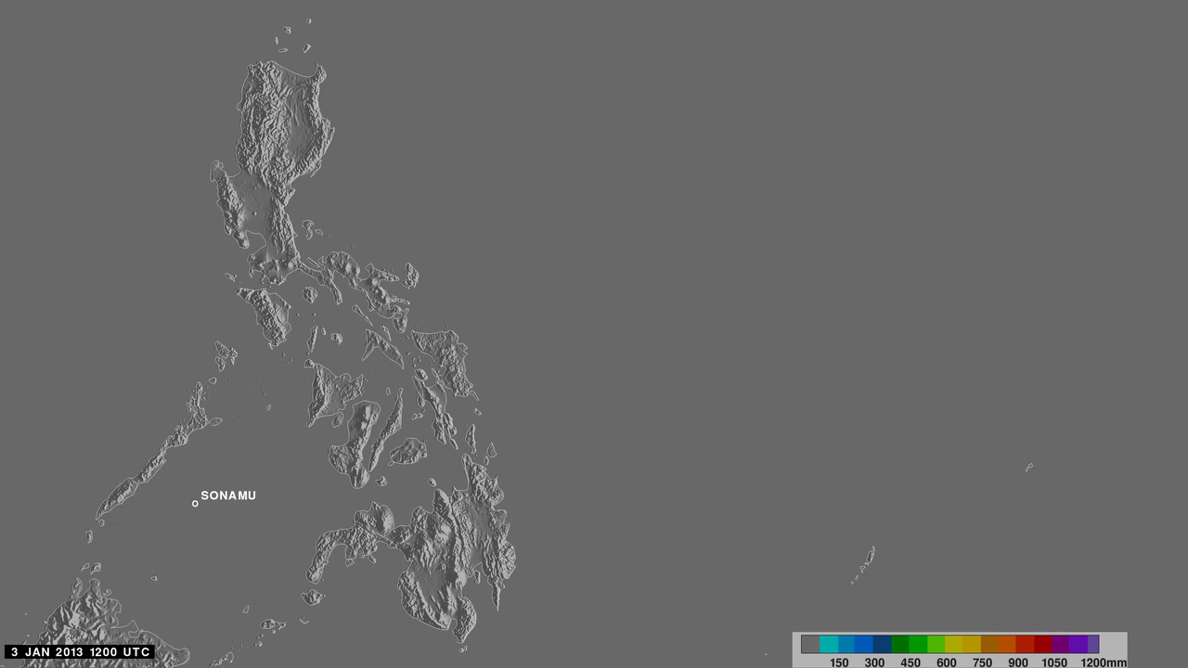
Notes:
2013 Rainfall over the Philippines
Nearly a year's worth of data show rainfall patterns over the Philippines.

