Slide 1
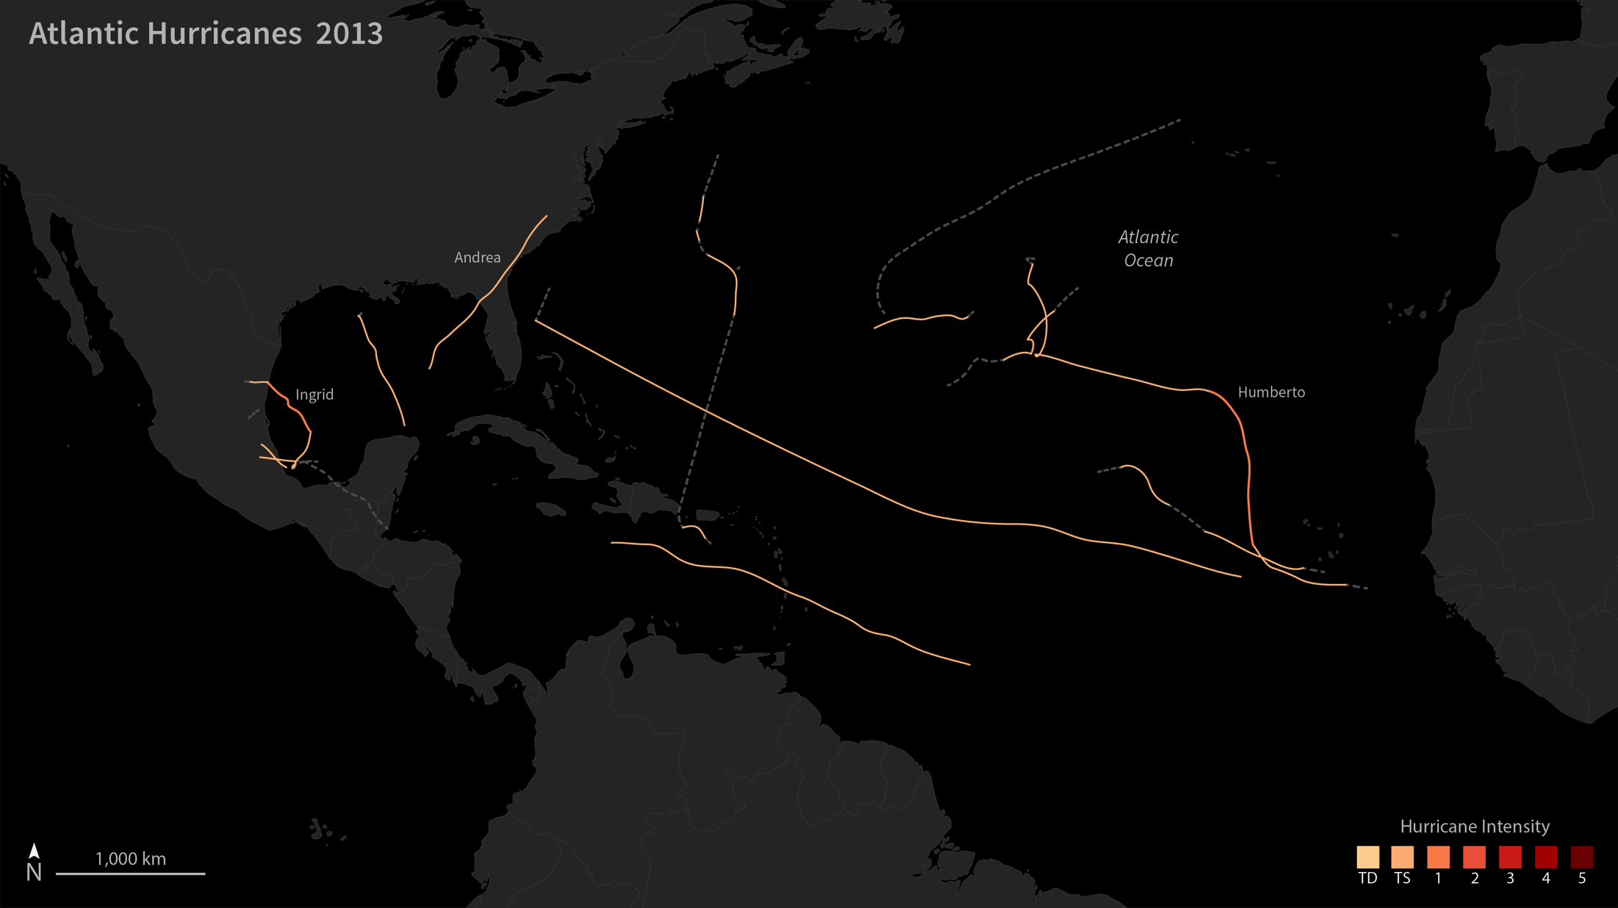
Notes:
2013 Atlantic Hurricane Season
This map shows the tracks and intensity of the tropical storms in the Atlantic basin in 2013. The color and width of each line reflects the intensity of the storm on each day of its activity.
In the Atlantic, 13 tropical storms were observed (plus one tropical depression), with just two developing into hurricanes—the fewest since 1982. None of the storms became major hurricanes, the first time that has happened since 1994. The U.S. National Weather Service ranked 2013 as “the sixth-least-active Atlantic hurricane season since 1950.”
“This unexpectedly low activity is linked to an unpredictable atmospheric pattern that prevented the growth of storms by producing exceptionally dry, sinking air, and strong vertical wind shear in much of the main hurricane formation region,” said Gerry Bell, lead seasonal hurricane forecaster at NOAA’s Climate Prediction Center. “Also detrimental were several strong outbreaks of dry and stable air that originated over Africa.”

Slide 2
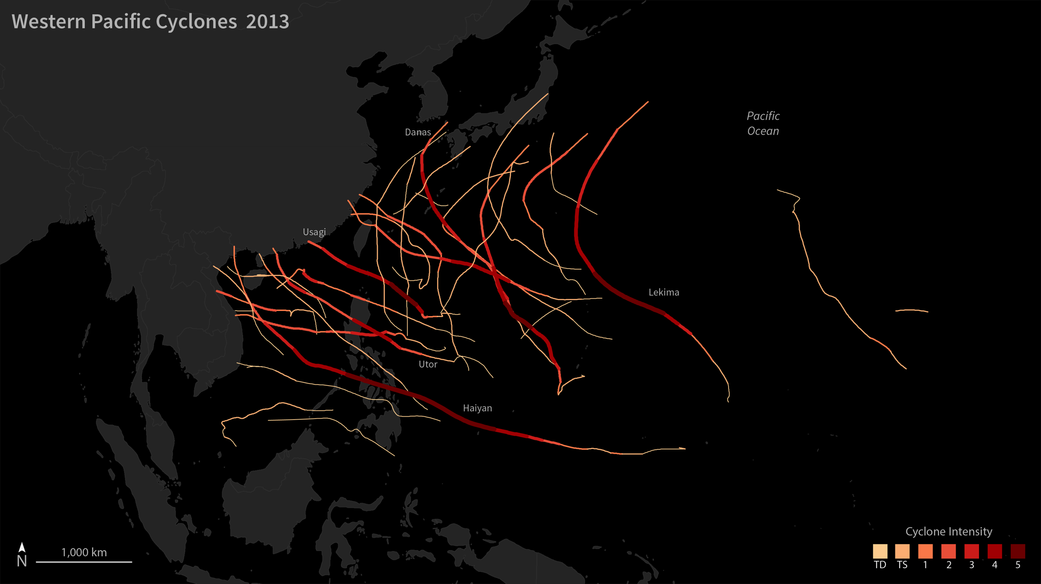
Notes:
2013 Western Pacific Typhoon Season
This map shows the tracks and intensity of the tropical storms in the Western Pacific basin in 2013. The color and width of each line reflects the intensity of the storm on each day of its activity. In 2013, there were between 28 and 31 tropical storms, and 13 to 16 typhoons—six of which reached super typhoon strength. According to the Tropical Storm Risk Consortium, the average is 26 tropical storms and 16 typhoons; other institutions have arrived at slightly different counts for the region.
Nearly one-third of the world’s tropical storms form in the Western Pacific in any given year. This is because the sea surface temperatures are among the warmest in the world; the mixed layer of the ocean is deeper; there are fewer land barriers; and the tropopause—the boundary between the lower atmosphere and the stratosphere—is very high and cold. Essentially, storms have more fuel and more room (horizontally and vertically) to grow in the Western Pacific.

