Slide 1
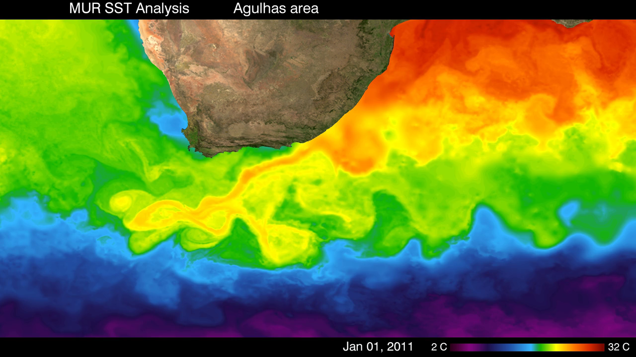
Notes:
This visualization from January 1, 2011 to December 31, 2013 shows sea surface temperatures (SST) associated with the Agulhas Current near South Africa at 1-kilometer (~0.6 mile) resolution. The Agulhas Current is a western boundary current that transports warm water in the Indian Ocean southward along Africa’s west coast. Near South Africa the current retroflects (turns back on itself), called the Agulhas Retroflection, due to interactions with the Antarctic Circumpolar Current. Eddies that form as a result of the retoflection are clearly visible in the visualization. These eddies can shed or spin off the main current and travel into the South Atlantic.
The Multi-scale Ultra-high Resolution (MUR) SST dataset, used to create this visualization, combines data from the Advanced Very High Resolution Radiometer (AVHRR), Moderate Resolution Imaging Spectroradiometer (MODIS), Advanced Microwave Scanning Radiometer for EOS (AMSR-E) instruments, and currently the U.S. Navy’s WindSat spacecraft.
Satellite: U.S. Navy’s WindSat spacecraft, Aqua, Terra, NOAA-15
Instruments: AVHRR, MODIS, AMSR-E

