Slide 1
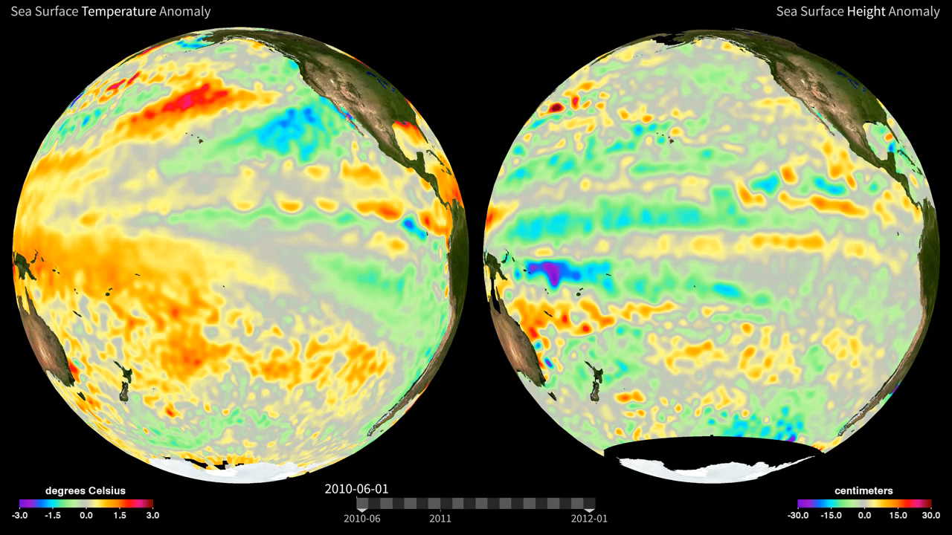
Notes:
This visualization from June 1, 2006 to December 31, 2011, illustrates the evolution of sea surface temperature (SST) and sea surface height (SSH) anomalies (relative to the respective normal state) associated with the 2010-2011 La Niña in the Pacific Ocean. SST and SSH anomalies reflect the heat content in the mixed layer (top 50 meters) and the upper ocean (top 150 meters), respectively.
Typically, warm SST anomalies are often associated with high SSH anomalies, while cold SST anomalies are associated with low SSH anomalies. Therefore, they provide complimentary views of the oceanic signature of climate variability such as El Niño and La Niña. La Niña is the cooling phase of an interannual mode of climate variability called El Nino-Southern Oscillation. Initial cooling appeared in the eastern to central equatorial Pacific around June 2010 and grew into a relatively strong La Niña event in late 2010. The event persists beyond February 2011.
Satellite:
INstrument:

