Slide 1
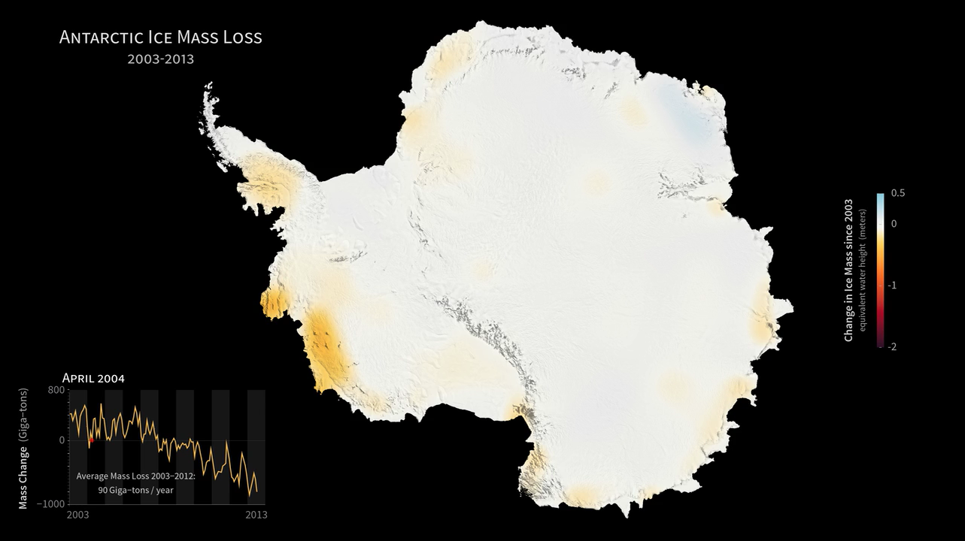
Notes:
The mass of the Antarctic ice sheet has changed over the last several years. Research based on observations from NASA's twin Gravity Recovery and Climate Experiment (GRACE) satellites indicates that between 2003 and 2013, Antarctica shed approximately 90 gigatons of ice per year, causing global sea level to rise by 0.25 millimeters per year.
These images, created with GRACE data, show changes in Antarctic ice mass since 2003. Orange and red shades indicate areas that lost ice mass, while light blue shades indicate areas that gained ice mass. White indicates areas where there has been very little or no change in ice mass since 2003. In general, areas near the center of Antarctica experienced small amounts of positive or negative change, while the West Antarctic Ice Sheet experienced a significant ice mass loss (dark red) over the ten-year period.
global_ssta_0378.dds
Satellite: GRACE

Slide 2
