Slide 1
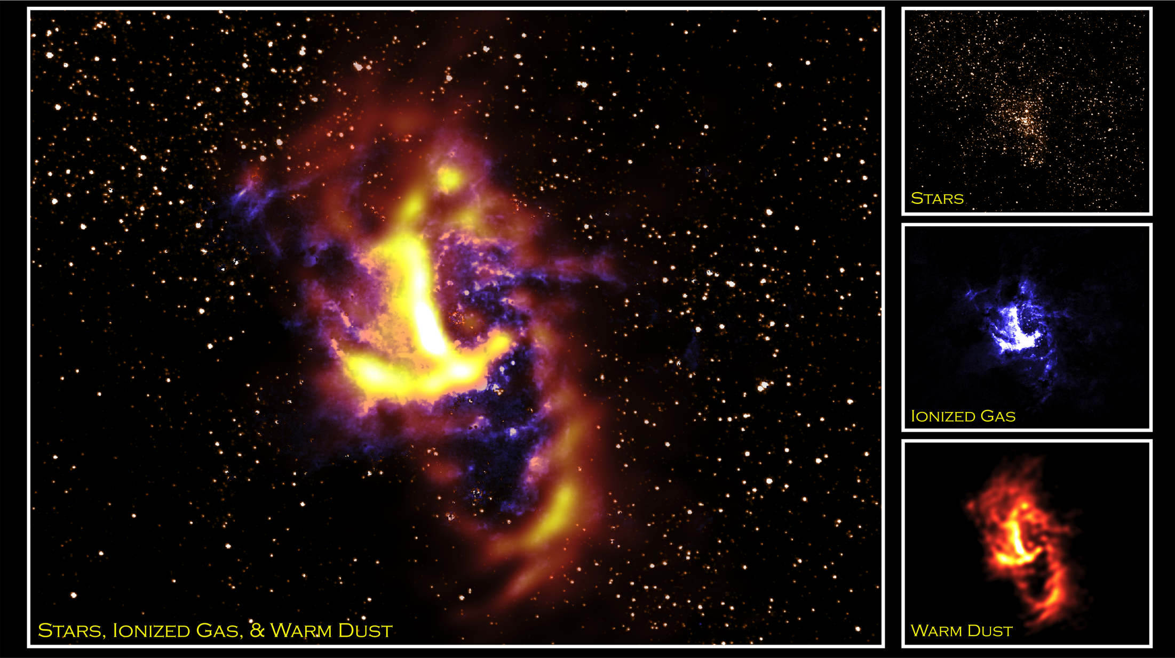
Notes:
The Circumnuclear Ring (CNR) is a torus of ionized gas and warm dust 10 light-years in diameter orbiting about Sagittarius A-star (Sgr A*), the 4-million solar-mass black hole at the center of the Milky Way Galaxy, 27,000 light-years from Earth. Large quantities of interstellar dust and gas between the Galactic center and Earth make it nearly impossible to study the CNR at visible or ultraviolet wavelengths. Fortunately, radiation at infrared wavelengths can pass through the clouds of dust and gas.
These images capture the infrared emission from stars (HST/NICMOS), ionized gas (HST/NICMOS), and warm dust (SOFIA/FORCAST) within the central 10 light-years of the Galaxy. A cluster of massive, young stars seen at the center of the upper right image is responsible for ionizing the gas (middle right image) and heating the dust (lower right image) in the CNR. Observations from the Stratospheric Observatory for Infrared Astronomy (SOFIA)/Faint Object Infrared Camera for the SOFIA Telescope (FORCAST) instrument present the highest spatial resolution images of the warm dust emission from the CNR at the far-infrared wavelengths and reveal its "clumpy" nature. Calculations predict that such clumps within the CNR should be ripped apart due to the strong tidal forces from Sgr A*, which means that the CNR will appear as a much different structure 50,000 years from now.
Satellite: HST
Airborne Telescope: SOFIA
Instruments: SOFIA/FORCASR, HSA/NICMOS

