Slide 1
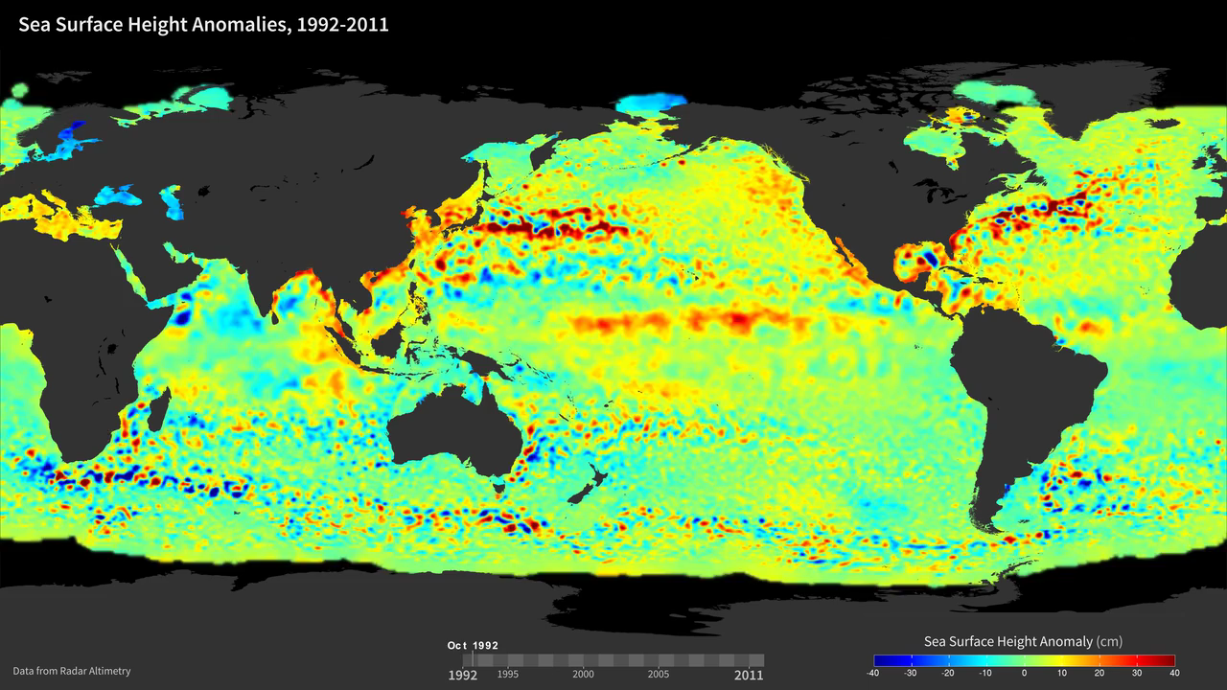
Notes:
Sea Surface Height Anomalies, 1992-2011
Using data from several satellite radar altimeters, a finer picture of the ever-changing height of the ocean is revealed. In this visualization, sea surface height anomalies derived from satellite altimeter data show differences above and below normally observed sea surface heights from 1992 to 2011. Blue shades indicate areas where sea surface height is lower than normal, while red shades indicate areas where sea surface height is higher than normal. Swirling currents called eddies pepper the scene and can be found in every major ocean basin. Near the Equator, ocean eddies give way to fast moving features called Kelvin waves. When they build up in the Pacific, these waves can usher in a phenomenon known as El Niño, which happens when warm water and high sea levels move into the Eastern Pacific along the Equator. Occurring roughly every 3-4 years, El Niño events can have a big impact on weather across the globe, bringing extra rainfall to the American Southwest and even affecting hurricanes in the Atlantic Oceans. Sea surface height data also have many other applications, such as in fisheries management, navigation, and offshore operations.
podaac.jpl.nasa.gov/AnimationsImages/Animations

