Slide 1
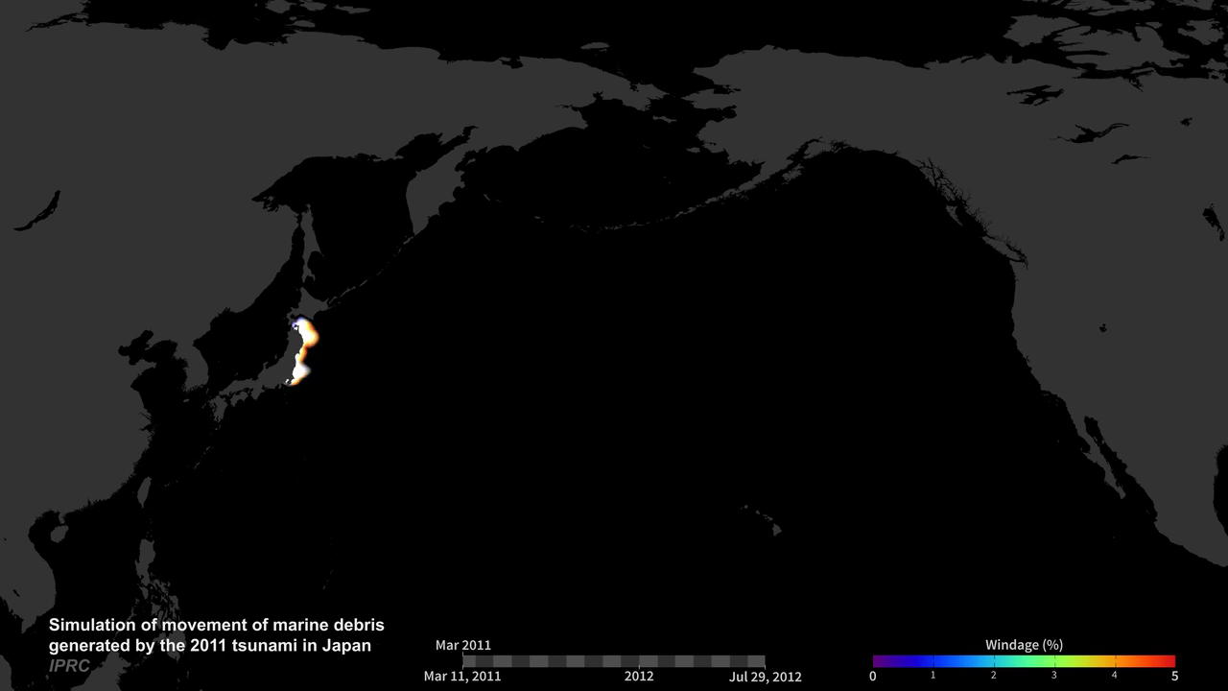
Notes:
Wind-Blown Marine Debris from Japanese Tsunami
On Friday, March 11, 2011, a magnitude 9.0 undersea megathrust earthquake struck off the Pacific coast of Japan that generated tsunami waves that reached 40.5 meters (~133 feet) high, traveling up to 10 kilometers (6 miles) inland in some areas (e.g., Sendai). The earthquake and resulting tsunami generated an estimated 24-25 million tons of rubble and debris in Japan. This simulation shows how winds near the ocean surface impacted the movement of marine debris as they moved across the Pacific from March 2011 to July 2012. The colors show the percentage of windage, or the amount of force (i.e., wind) created on an object by friction. Objects that float mostly above water are more impacted by the speed of the wind than the speed of the water; therefore, they have high windage values (orange and red shades). These objects move more quickly than objects that float mostly below water that are impacted more by the speed of the water and thus have low windage values (purple and blue shades). The results were used to assess the location of the tsunami debris in the ocean and the timeline of its arrival on the west coast of the United States. The International Pacific Research Center, Surface Currents Diagnostic model was used to run the simulation.
podaac.jpl.nasa.gov/AnimationsImages/Animations
Model: Surface Currents Diagnostics model

