Slide 1
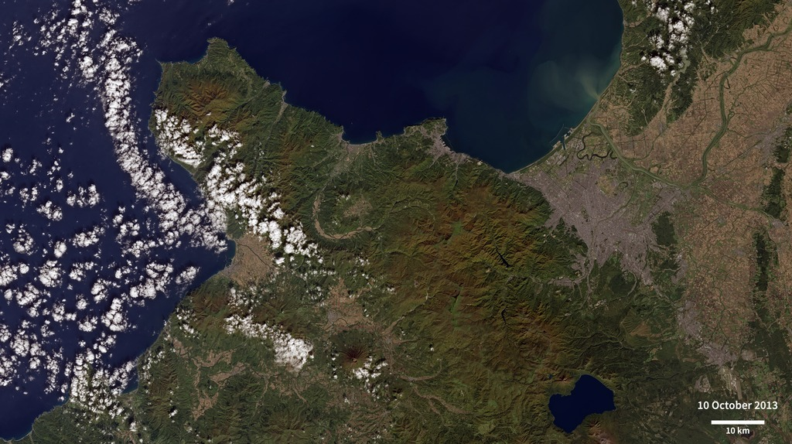
Notes:
Exploring Sapporo, Japan
Located on the northern island of Hokkaido, Sapporo is Japan’s fourth-largest city by population. These two images taken by Landsat 8 show Sapporo and its surrounding area on October 10, 2013 and April 20, 2014. In both images the urban city appears gray. Close by, several rectangular agricultural fields (tan and brown) can be seen sprawling eastward. West of the city center, mountains fill the scene. Mount Yōtei, an active stratovolcano located in Shikotsu-Toya National Park, can be seen near the bottom center of the images.
Sapporo has a continental climate that offers the full gamut of seasons and a wide variety of temperatures throughout the year. In the October image, the fall leaves in the highest elevations have already begun transitioning into shades of orange and brown. Sapporo receives an average of approximately 360 centimeters (250 inches) of snowfall each year, making it one of the snowiest cities in the world and an ideal site for winter activities. The city hosts its annual Sapporo Snow Festival in February each year, and hosted the Winter Olympics in 1972. The April image shows that even in early spring, there is still plenty of snow covering the nearby mountains.
Satellite: Landsat 8

Slide 2
