Slide 1
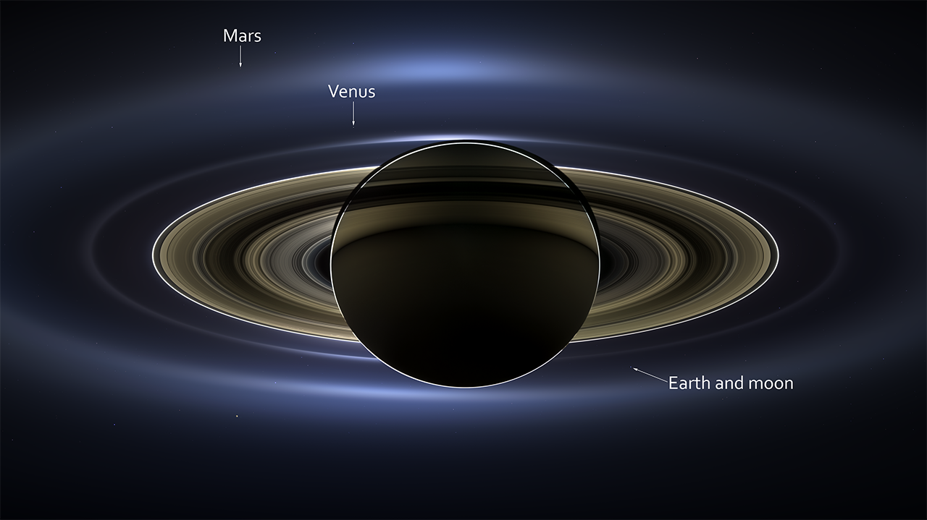
Notes:
The Day the Earth Smiled
On July 19, 2013, in an event celebrated the world over, NASA's Cassini spacecraft slipped into Saturn's shadow and turned to image the planet, seven of its moons, its inner rings, and, in the background, our home planet, Earth. With the sun's powerful and potentially damaging rays eclipsed by Saturn itself, Cassini's onboard cameras were able to take advantage of this unique viewing geometry. They acquired a panoramic mosaic of the Saturn system that allows scientists to see details in the rings and throughout the system as they are backlit by the sun.
With both Cassini's wide-angle and narrow-angle cameras aimed at Saturn, Cassini was able to capture 323 images in just over four hours. This final mosaic uses 141 of those wide-angle images. Images taken using the red, green and blue spectral filters of the wide-angle camera were combined and mosaicked together to create this natural-color view. This image spans about 404,880 miles (651,591 kilometers) across.
Satellite: Cassini
Instrument: Imaging Science Subsystem - Narrow Angle

