Slide 1
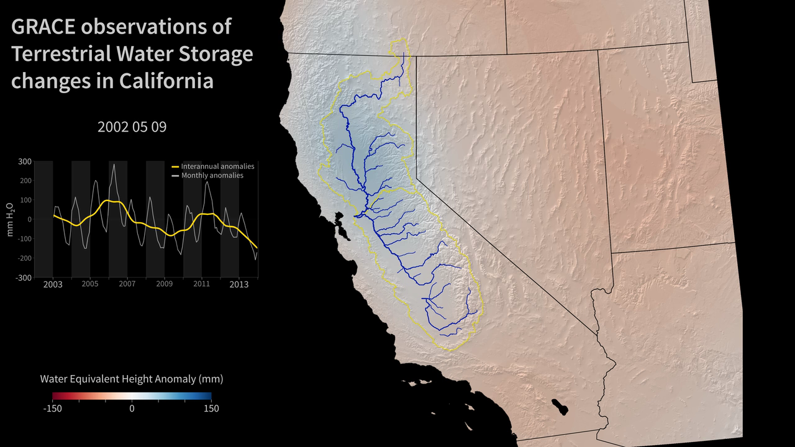
Notes:
California’s Deepening Drought
GRACE images show groundwater depletion in California’s Central Valley.
NASA’s Gravity Recovery and Climate Experiment (GRACE) mission, launched in 2002, maps changes in Earth's gravity field resulting from the movement of water over the planet. This animation shows how the total amount of water (snow, surface water, soil moisture, and groundwater) varies in space and time, with the passage of dry seasons and wet seasons as well as with flooding, drought, and transport due to water management. Blue colors represent wetter than average conditions (relative to 2002-2013), while red colors represent drier than average conditions. The graph at left shows the monthly changes for the average of the region outlined in yellow. The yellow line in the graph shows interannual variations.
The Sacramento and San Joaquin River basins are outlined in yellow and rivers and tributaries are shown as blue lines. The basins include California's Central Valley, the most productive agricultural region in the U.S. Ongoing drought in California has drained the state of nearly 15 cubic kilometers (12 million acre feet; 4 trillion gallons) of water in each of the last 3 years. Much of the loss is a result of groundwater depletion. Limited rainfall and snowmelt throughout the state has forced agriculture and cities to rely more heavily on groundwater reserves, resulting in rapid depletion of the aquifer. At least 50% of the annual water loss is due to the removal of groundwater.
Satellite: GRACE

