Slide 1
Notes:
McMurdo Panorama
This 360-degree view, called the McMurdo panorama, comes from the panoramic camera (Pancam) on NASA's Mars Exploration Rover Spirit. From April through October 2006 (winter on southern Mars) Spirit stayed on a small hill known as Low Ridge. The panorama was stitched together from 1,449 Pancam images acquired during this time. Despite the long span of time needed for acquiring the images, lighting and color are remarkably uniform across the image. This attests to the uniform weather of wintertime sols (a sol is a Martian day) on Mars in the southern hemisphere. At this time of year when Mars is farthest from the sun, there is much less dust storm and dust devil activity.
The surroundings of Spirit's Winter Haven are presented in nearly true color. Many porous-textured, dark volcanic rocks can be seen, including many on Low Ridge. Two brighter and smoother-looking rocks to the right of center are thought to be meteorites. On the right, Husband Hill on the horizon, the rippled El Dorado sand dune field near the base of that hill, and lighter-toned Home Plate below the dunes provide context for Spirit's travels since mid-2005. On the left, tracks and a trench dug by Spirit's right-front wheel, which no longer rotates, have exposed bright underlying material, which is evidence of sulfur-rich salty minerals in the subsurface, and which may provide clues about the watery past of this part of Gusev Crater.

Slide 2
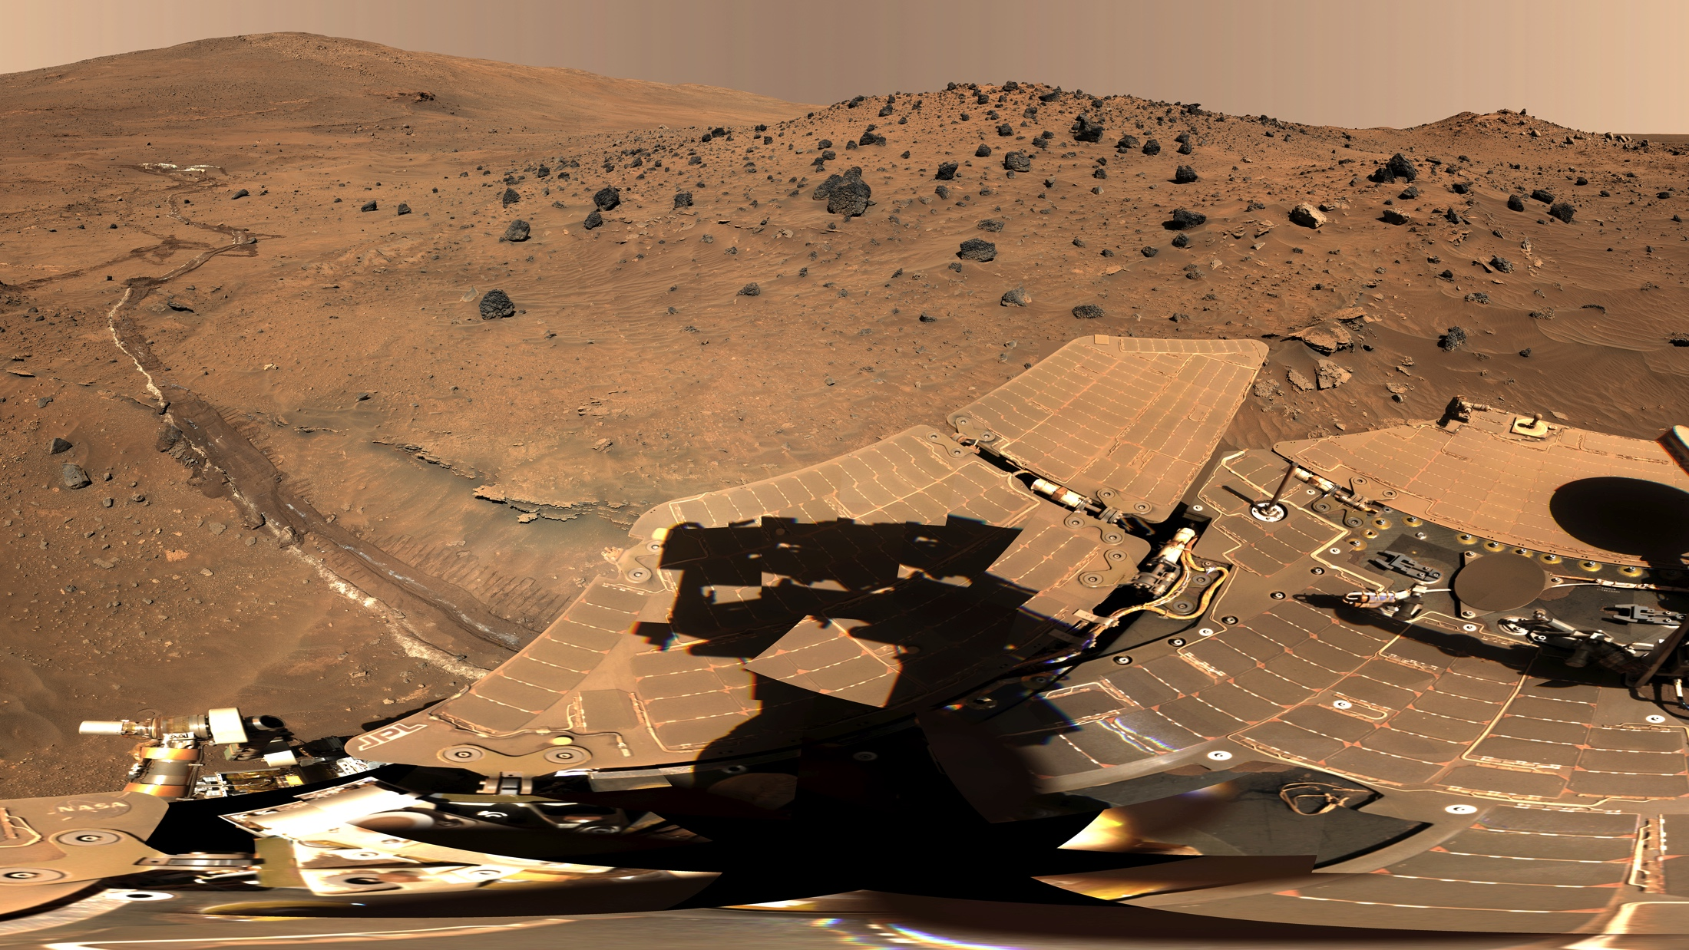

Slide 3
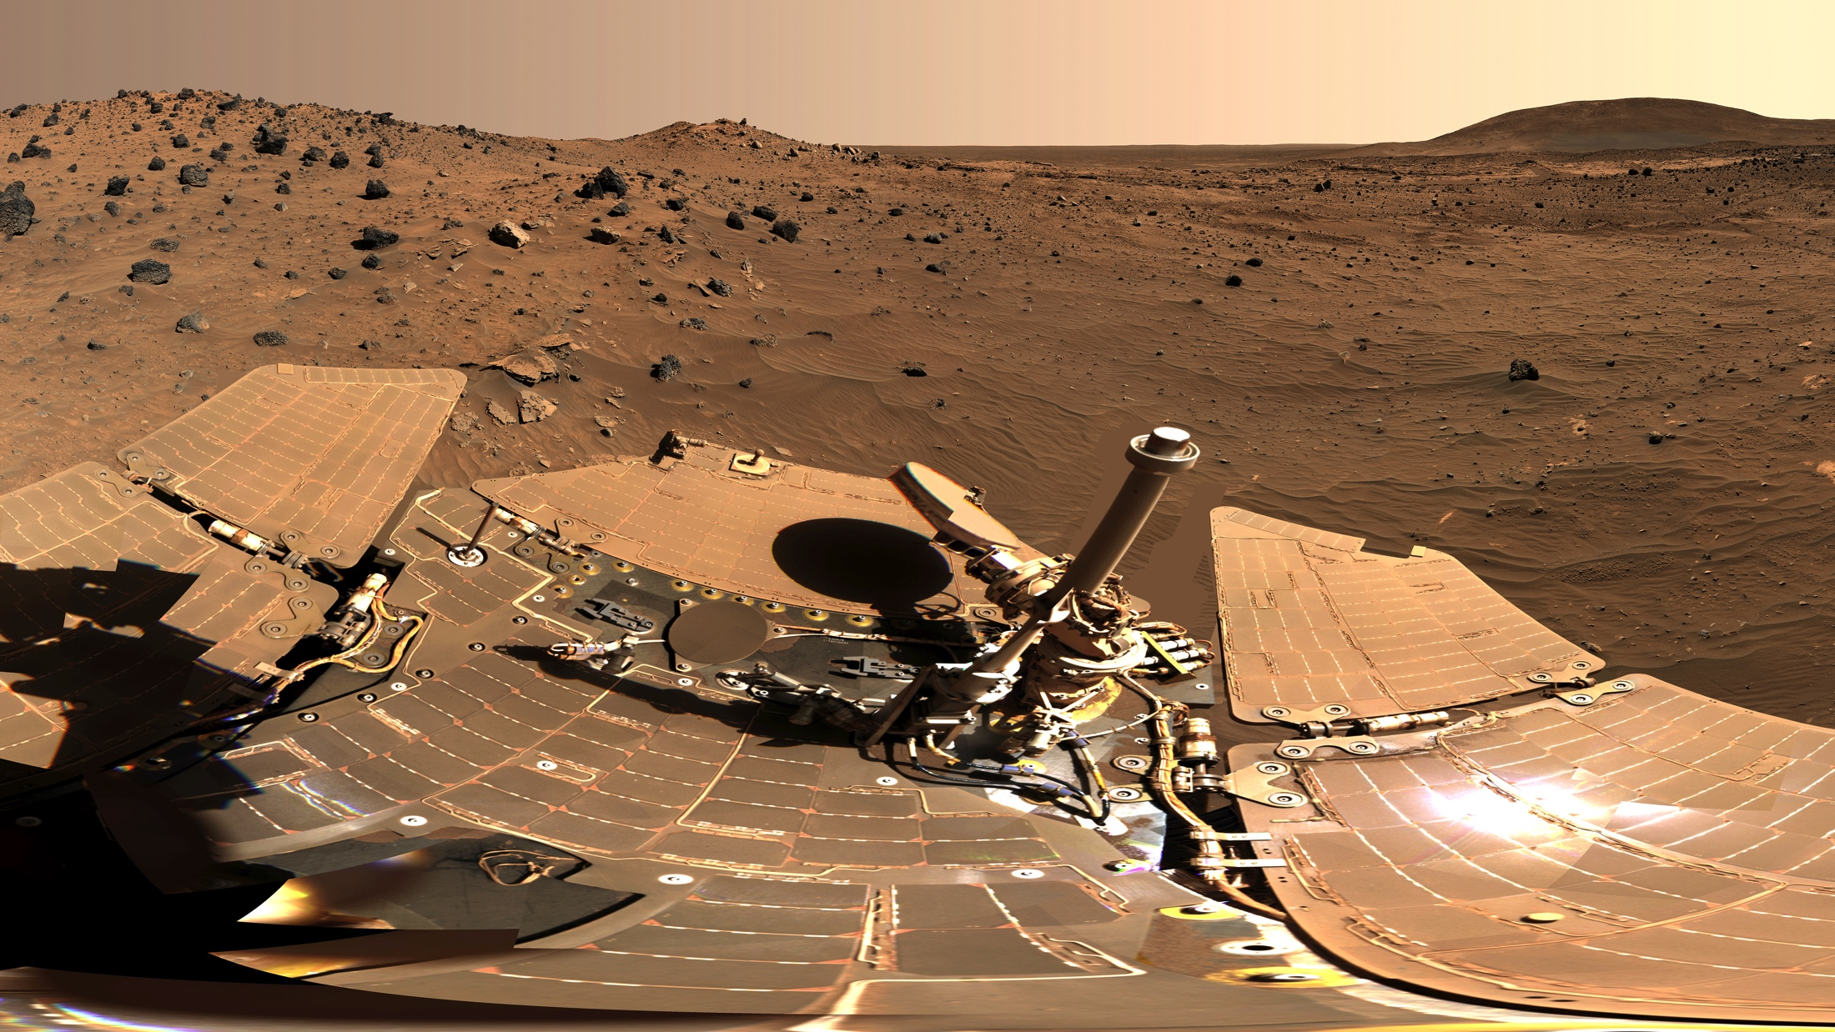

Slide 4
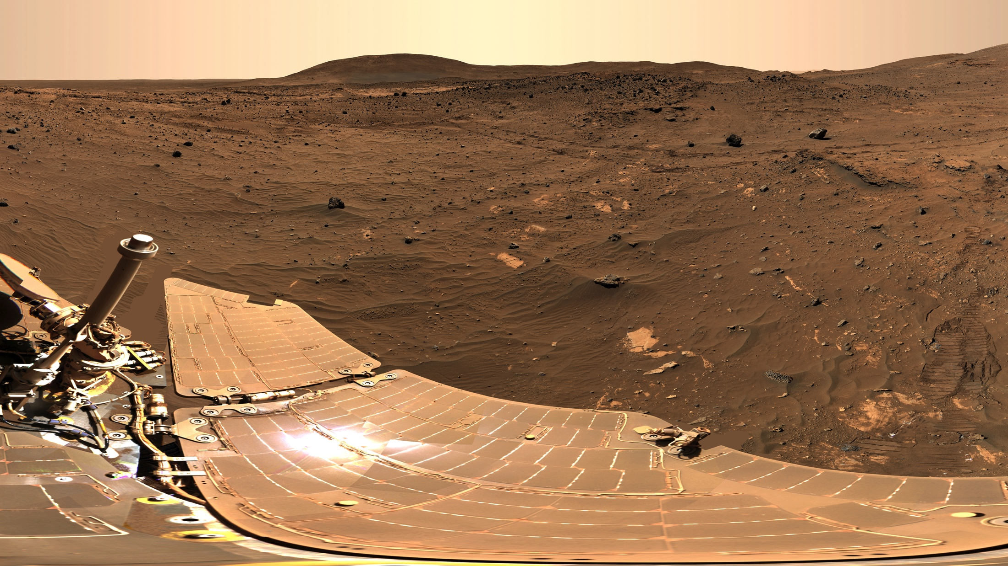

Slide 5
