Slide 1
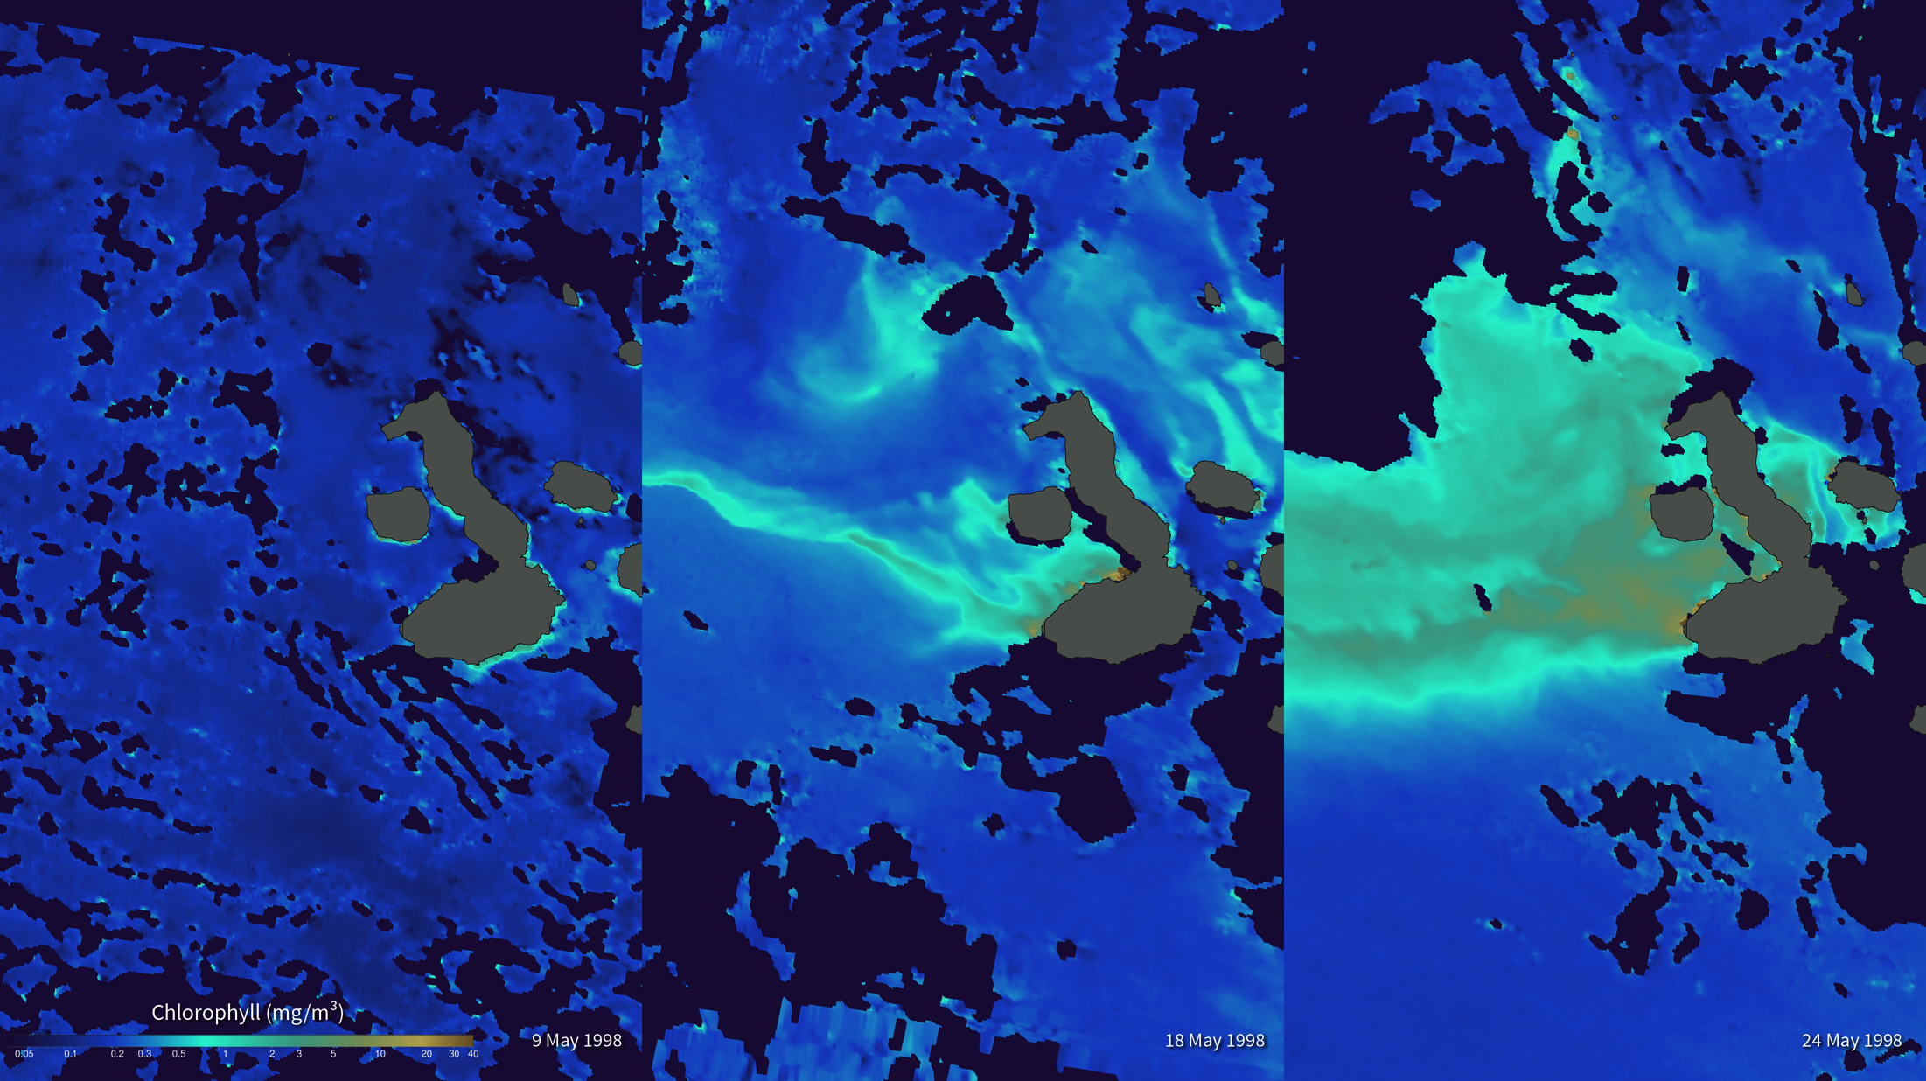
Notes:
Galápagos Blooms After El Niño
The 1997-98 El Niño was the strongest on record. The surface water in the Pacific off the coast of South America was significantly warmer than normal. This warm water trapped the ocean nutrients and led to a drastic decrease in phytoplankton and other ocean life in the region. The unique Galápagos ecosystem was severely affected and many species, including sea lions, seabirds, and barracudas, suffered a very high mortality level.During the start of a La Niña (in May 1998), ocean temperatures dropped dramatically and the ocean productivity exploded with large phytoplankton blooms. Many species recovered very rapidly and the land species started to reproduce immediately.
These images, created with data from NASA’s Sea-viewing Wide Field-of-view Sensor (SeaWiFS) instrument, show phytoplankton concentrations in the Galápagos Marine Reserve (surrounding the Galápagos Islands) on May 9, May 18, and May 24, 1998. Blue shades represent little or no phytoplankton, while shades of teal, green, and tan indicate increasing ocean productivity. Dark blue denotes missing data while the islands are shown in gray. SeaWiFS monitors global chlorophyll pigments in phytoplankton that allow scientists to monitor the blooms from space.
Satellite: SeaWiFS

