Slide 1
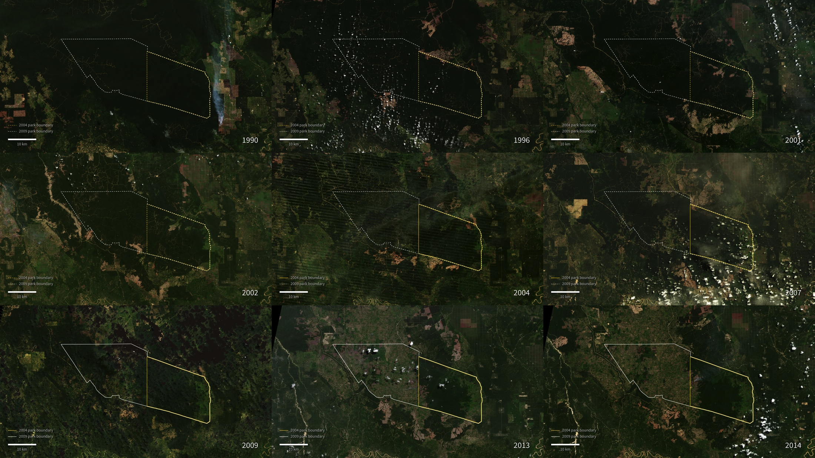
Notes:
Land Cover Change in Tesso Nilo National Park
Tesso Nilo National Park in Sumatra encompasses an area of rich plant and animal diversity, providing habitats for the critically endangered Sumatran elephants and tigers. This series of Landsat images begins in 1990, where it shows the relatively undisturbed natural lush forest (dark green) in the area that would become the national park in 2004 (outlined in yellow). The park was later expanded in 2009 (outlined in white).
Over the years, Landsat imagery shows a loss of natural forest in the park area and surrounding forest-logging concessions. The biggest driver of deforestation in Indonesia is agriculture. The logged areas initially appear brown or red, but take on a green color as palm plantations mature, replacing the original forest. Though the replanted areas appear similar to the natural forest in Landsat imagery, they no longer support the original diversity of plant and animal species.
Satellite: LandSat

