Slide 1
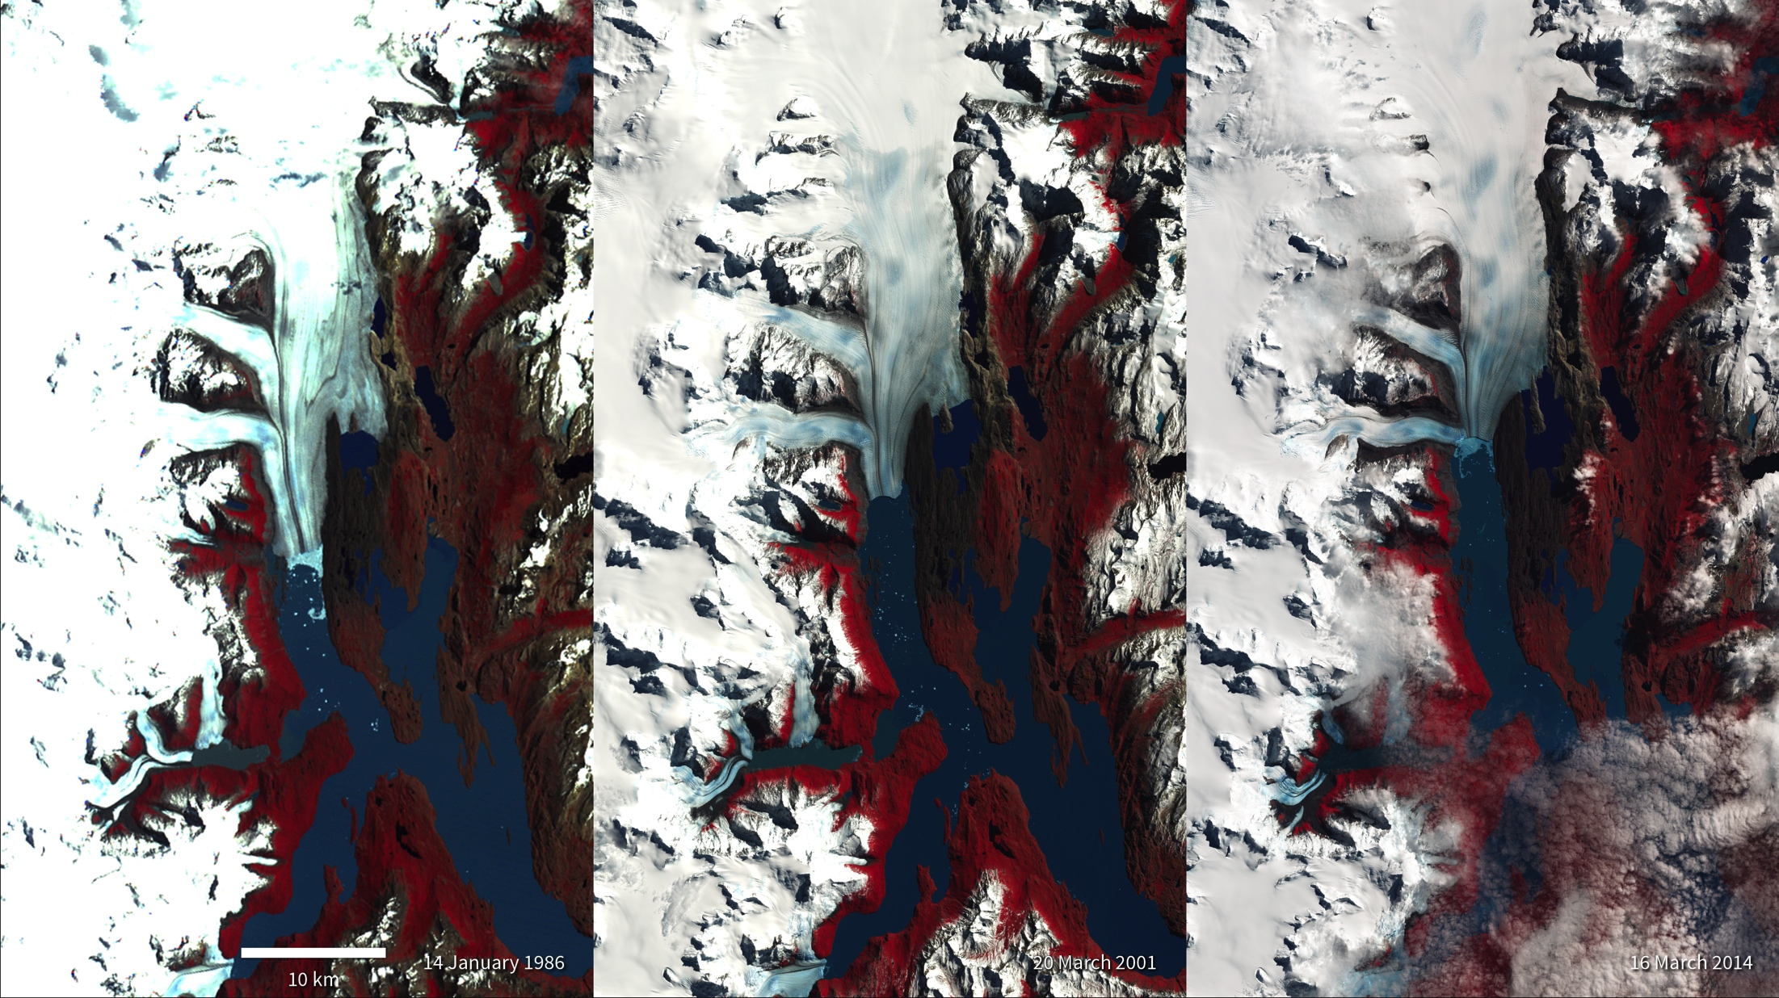
Notes:
Upsala Glacier Retreat in Argentina
Many glaciers around the world are in retreat due to rising global temperatures. These Landsat images of Upsala Glacier in Los Glaciares National Park, located in the Andean Mountains in Argentina, show how the glacier has retreated 7.2 kilometers (~4.5 miles) between 1986 and 2014—a rate of approximately 260 meters (~853 feet) per year.
A smaller, side glacier joins Upsala at the present-day ice front—the wall from which masses of ice periodically collapse into Lago (Lake) Argentino. A mixture of sea ice, icebergs, and snow, called an ice mélange, is visible at the edge of the ice wall (blue) in both the 1986 and 2014 images due to ice calving events. Larger icebergs appear as white dots on the lake surface in all three images. Glacier retreat in this part of South America is believed to be caused by local climatic warming. The warming not only causes the ice front to retreat but more importantly, causes overall thinning of the glacier ice mass.
Satellite: LandSat

