Slide 1
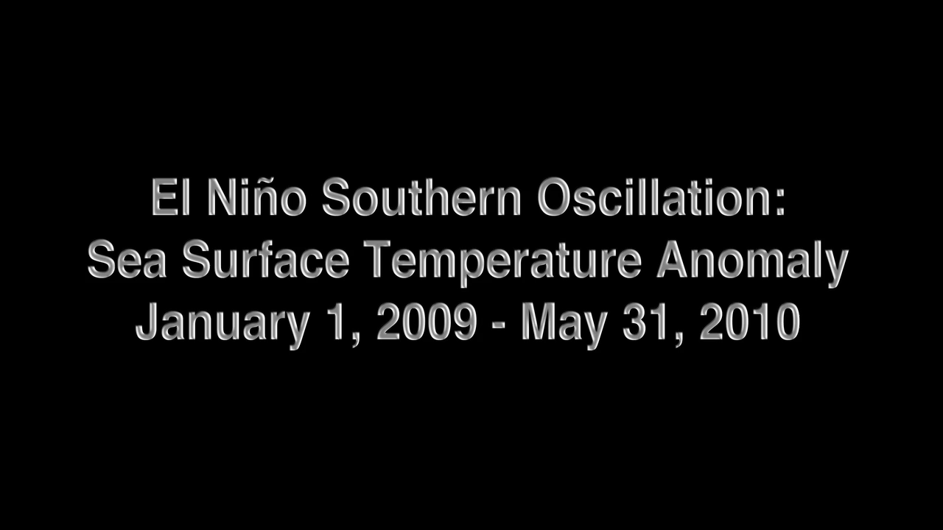
Notes:
ENSO Sea Surface Temperature Anomalies: 2009-2010
The animation illustrates the evolution of sea surface temperature (SST) anomalies (relative to the respective normal state) in the Pacific Ocean associated with the 2009-10 El Niño, the warm phase of an interannual mode of climate variability called El Niño-Southern Oscillation, or ENSO. SST anomalies reflect the heat content in the mixed layer (upper 50 meters of the ocean). This product uses optimal interpolation (OI) using data from the 4 km Advanced Very High Resolution Radiometer (AVHRR) Pathfinder Version 5 time series (when available, otherwise operational NOAA AVHRR data are used) and in situ ship and buoy observations.
Initial warming appeared in the eastern equatorial Pacific around May 2009 and grew into a moderate El Niño event by the end of the year. The Pacific is Earth’s largest ocean, so it shouldn’t be surprising that ENSO is the single biggest influence on the average temperature, rainfall, and vegetation conditions in the tropics.
Instrument: NCDC-L4LRblend-GLOB-AVHRR_OI

