Slide 1
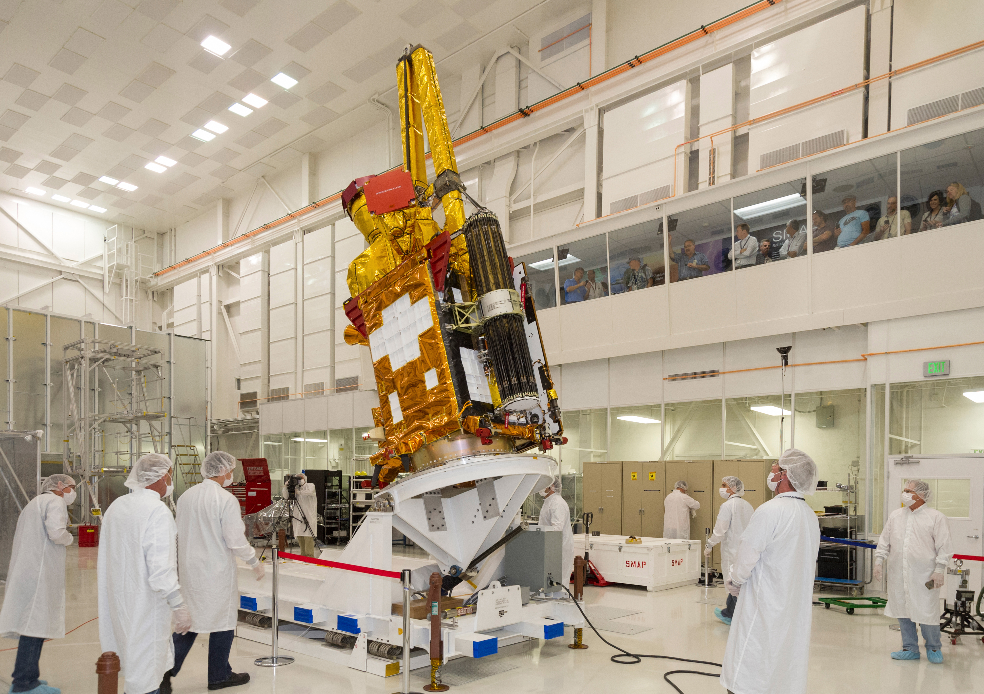
Notes:
SMAP prepared for shipping
NASA's Soil Moisture Active Passive (SMAP) spacecraft is slowly lowered into place in the Spacecraft Assembly Facility at NASA's Jet Propulsion Laboratory, Pasadena, California, in preparation for shipping to California's Vandenberg Air Force Base on Oct. 15.
For more information:
http://smap.jpl.nasa.gov

