Slide 1
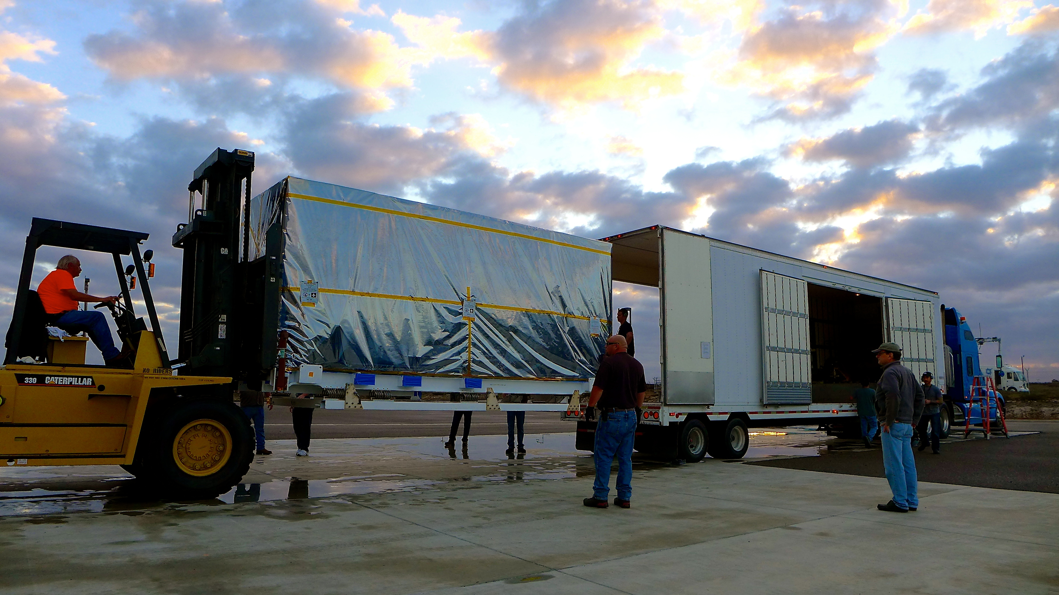
Notes:
SMAP arrives at launch site
The transportation canister containing NASA's Soil Moisture Active Passive (SMAP) spacecraft is offloaded from the truck that delivered it from NASA's Jet Propulsion Laboratory in Pasadena, California, to the Astrotech payload processing facility on Vandenberg Air Force Base in California.
For more information:
http://smap.jpl.nasa.gov

