Slide 1
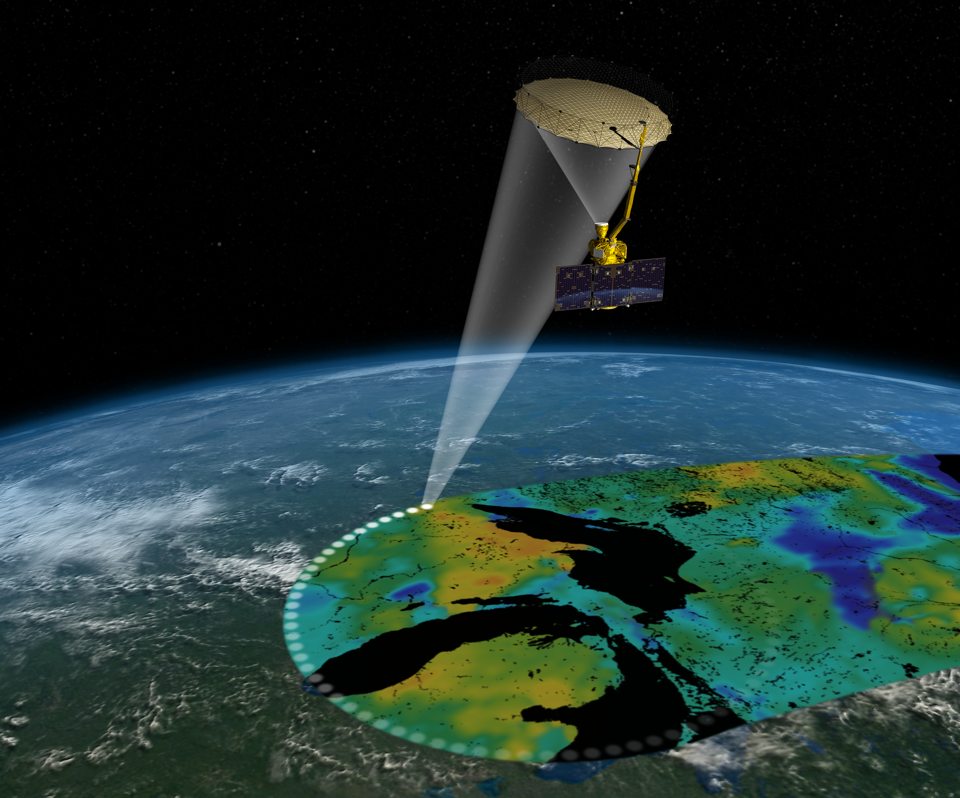
Notes:
Illustration of SMAP in orbit

