Slide 1
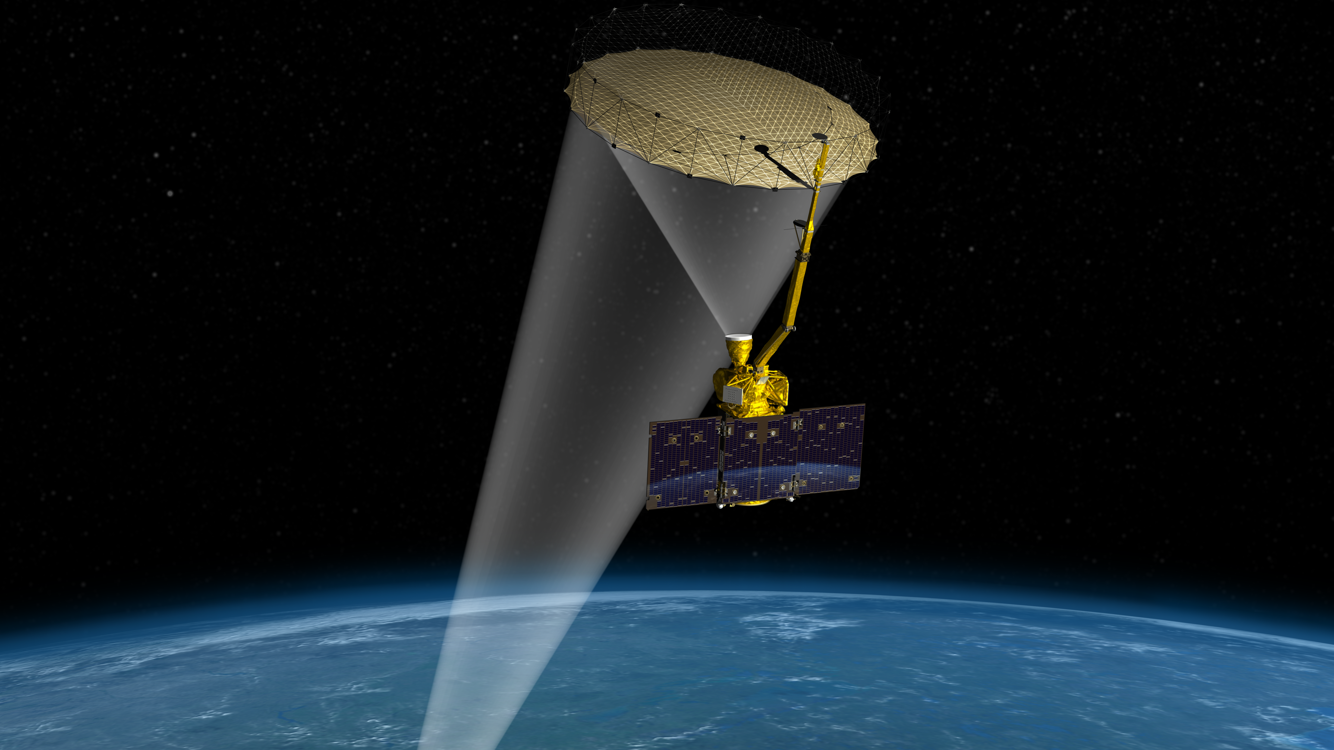
Notes:
Zoomed in view of SMAP illustration

