Slide 1
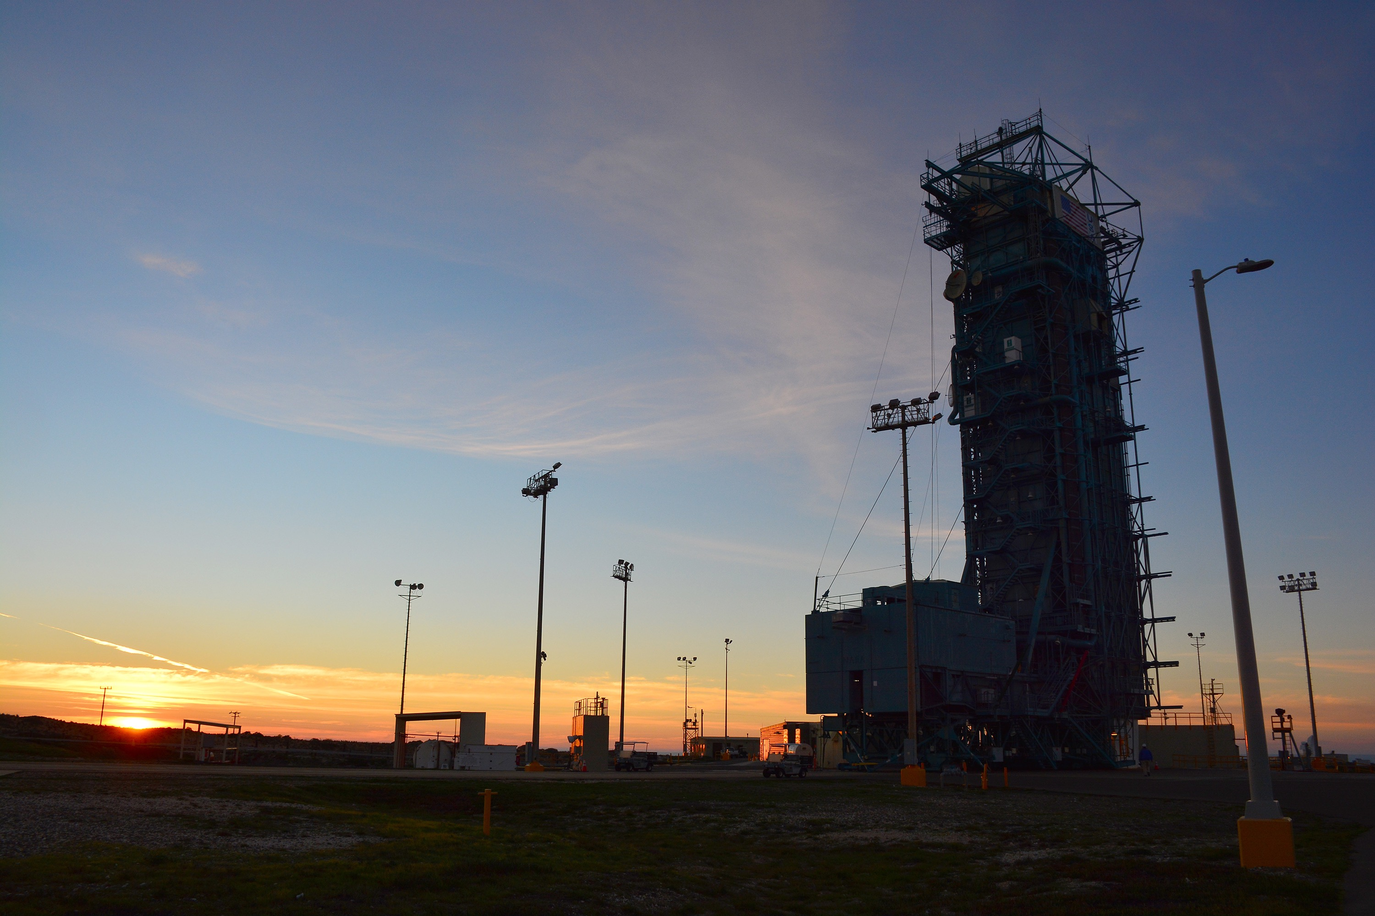
Notes:
SMAP at sunset
The sun sets behind Space Launch Complex 2, Vandenberg Air Force Base, California, where NASA's Soil Moisture Active Passive mission satellite is being prepared for liftoff. SMAP will provide a complete global measurement of soil moisture every two to three days and will also measure the soil's freeze/thaw state every two days at northern latitudes. Launch is scheduled for Jan. 29.
For more information:
http://smap.jpl.nasa.gov

