Slide 1
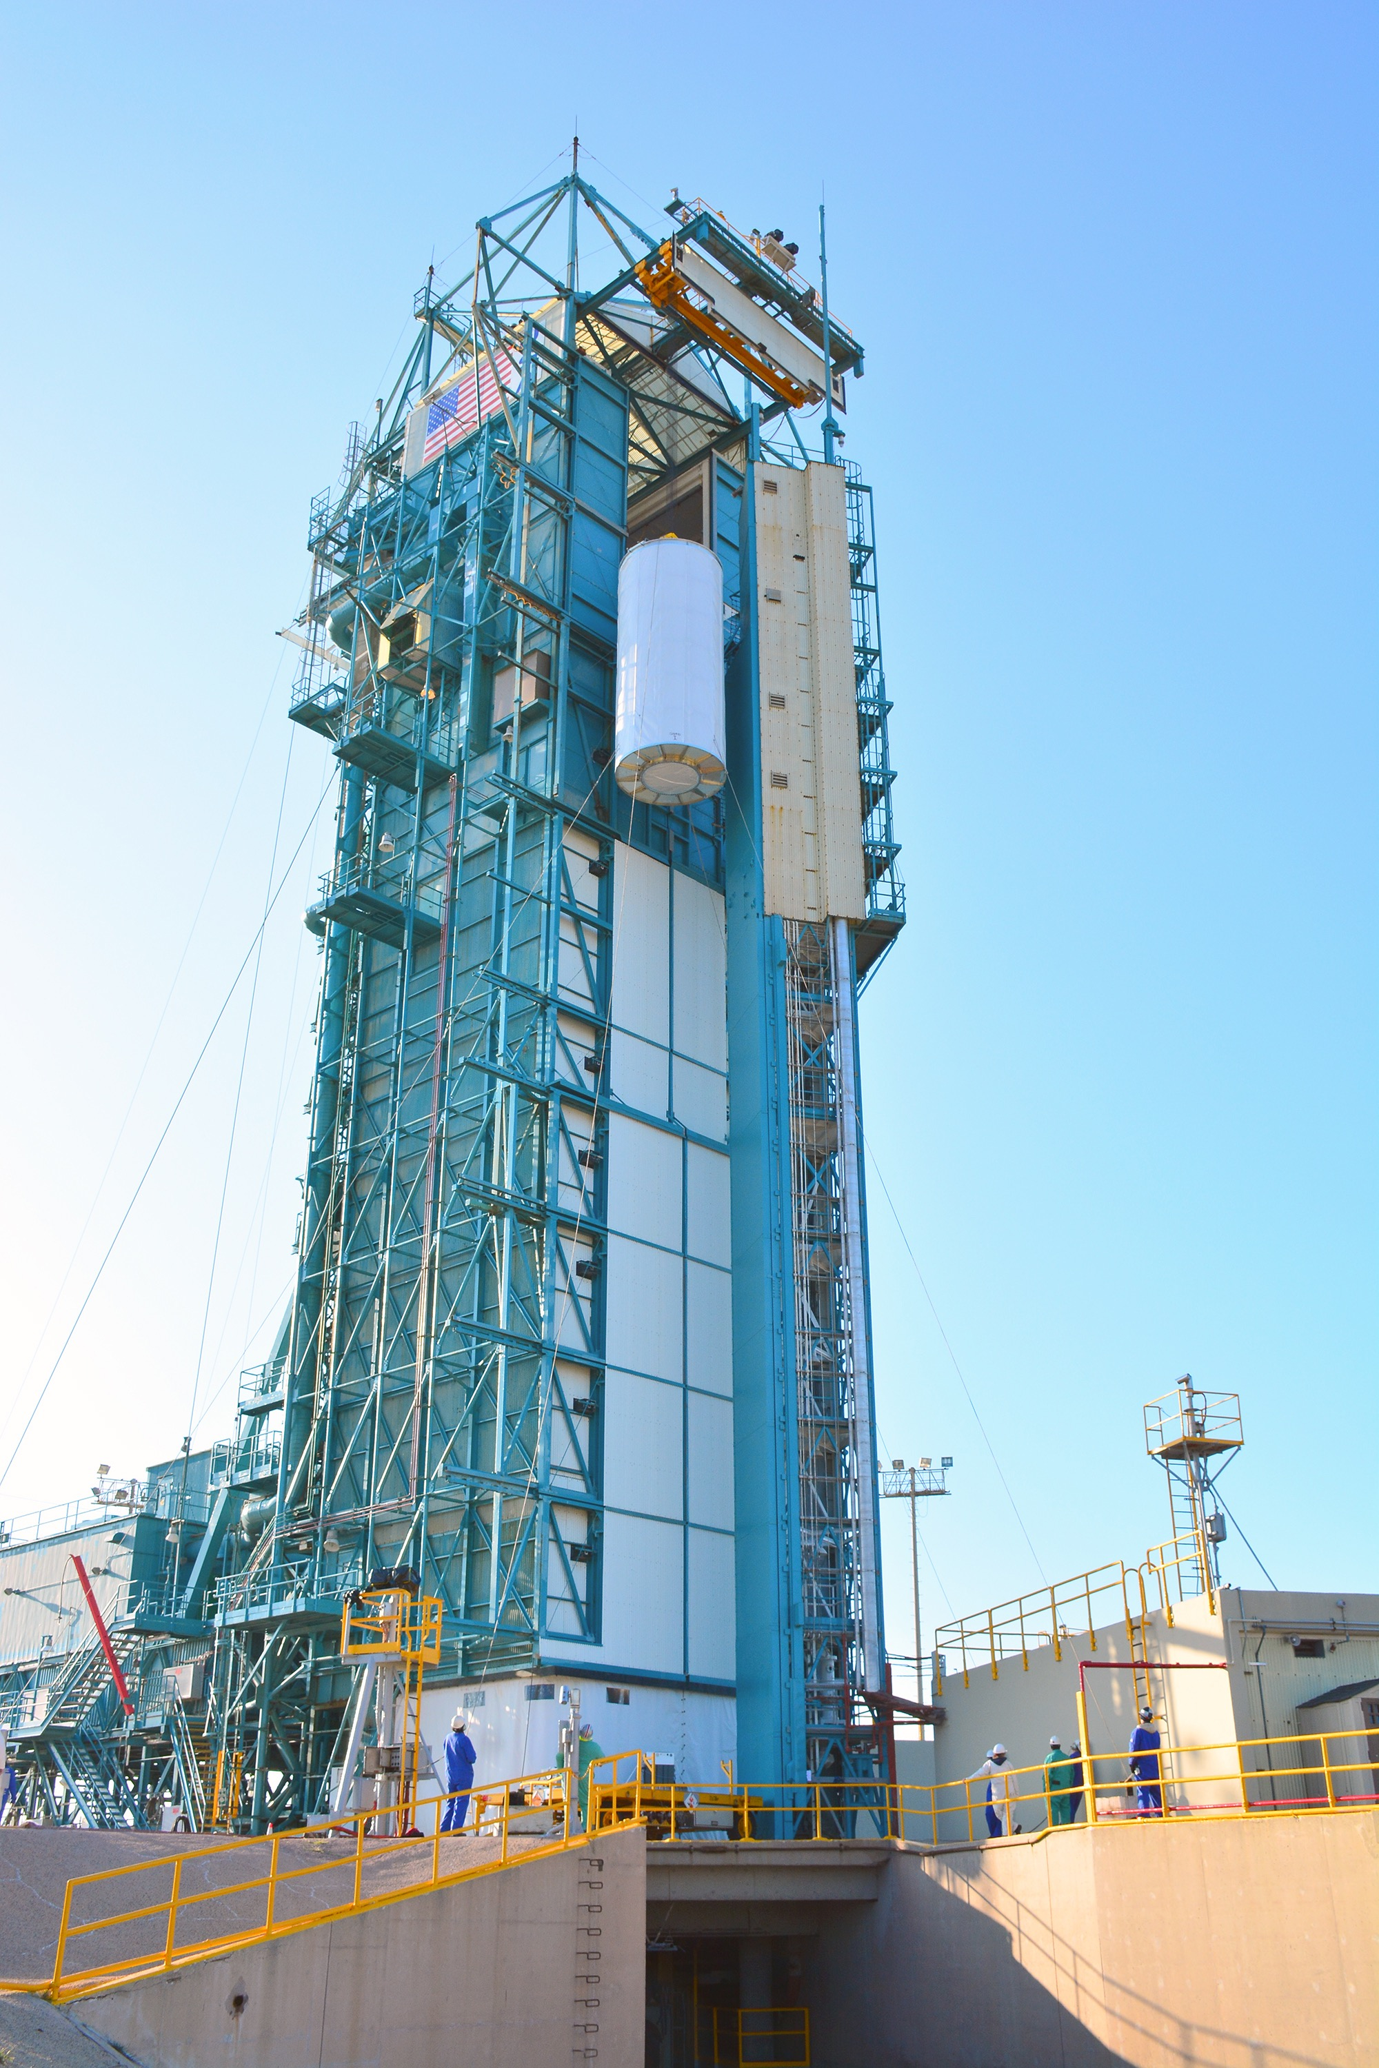
Notes:
SMAP going up
At Space Launch Complex 2 on Vandenberg Air Force Base in California, NASA's Soil Moisture Active Passive mission satellite is lifted up the side of a mobile service tower for mating to its Delta II rocket.
For more information:
http://smap.jpl.nasa.gov

