Slide 1
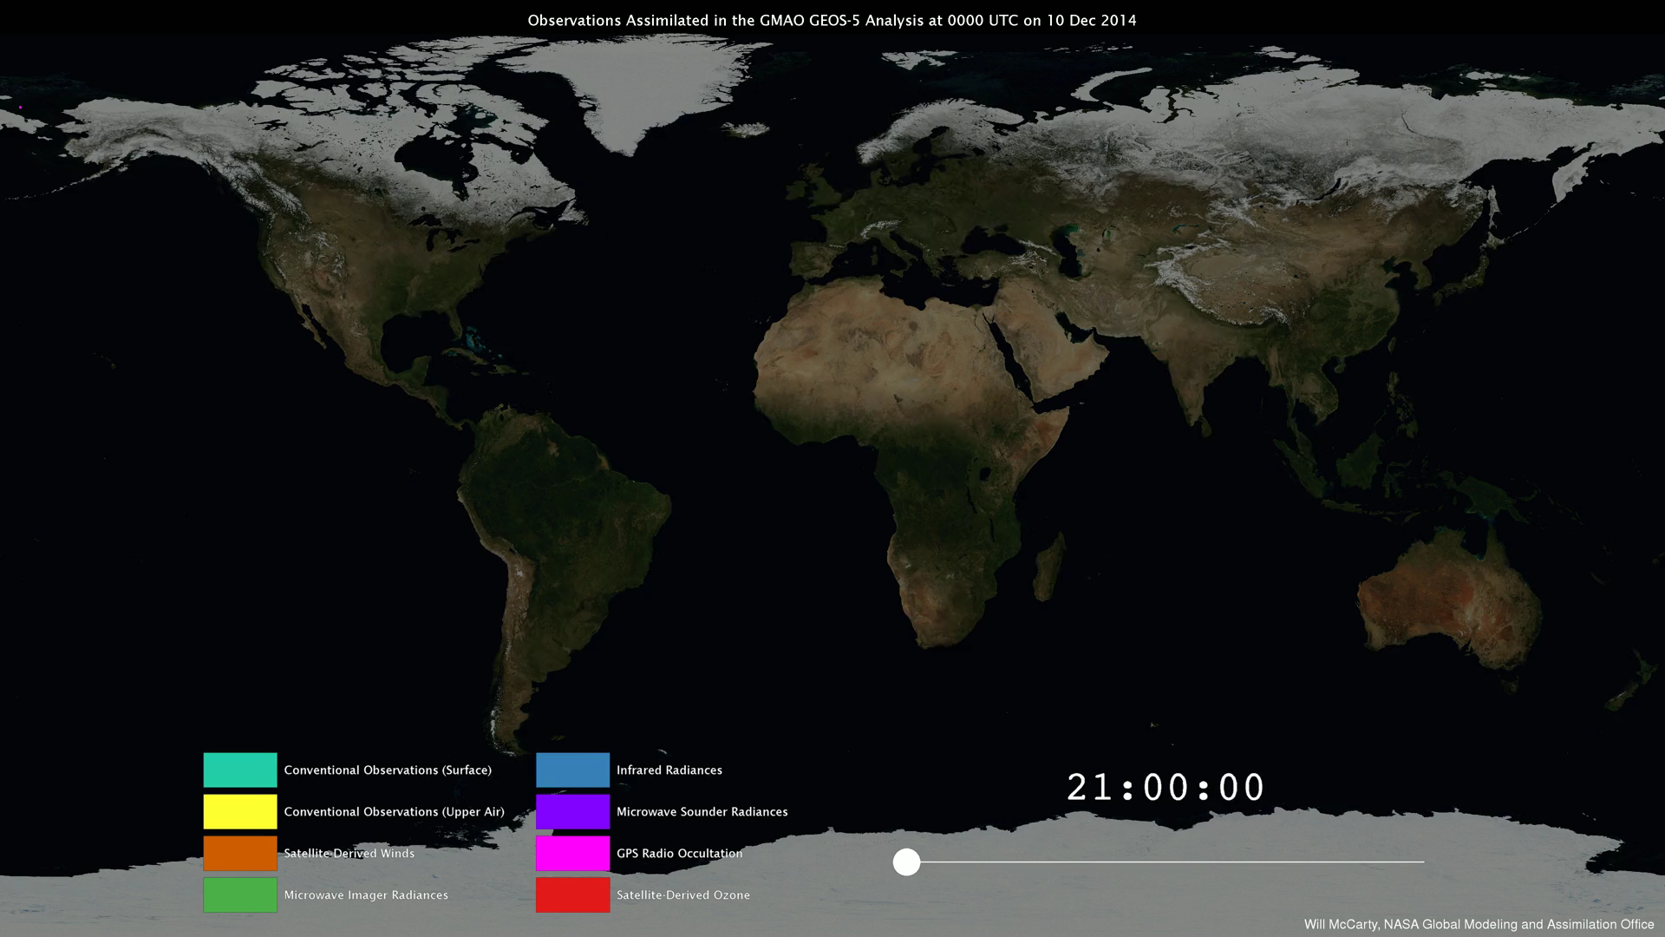
Notes:
From Observations to Models
NASA’s Global Modeling and Assimilation Office (GMAO) uses the Goddard Earth Observing System Model, Version 5 Data Assimilation System (GEOS-5 DAS) to produce global numerical weather forecasts four times a day.
For each forecast, it is necessary to combine the latest observations from satellites, aircraft, and ground stations with a short-term, 6-hour forecast—a process known as data assimilation. The GEOS-­5 DAS assimilates more than 5 million observations during each 6-hour assimilation period.
These observations are assembled from a number of sources from around the globe, including NASA, NOAA, EUMETSAT, commercial airlines, the U.S. Department of Defense, and many others. This visualization shows how different observation types have different strategies. One of the main challenges of data assimilation is to understand how all these observations are alike, how they differ, and how they interact with each other.
For more information, visit
svs.gsfc.nasa.gov/cgi-bin/details.cgi?aid=30590

