Slide 1
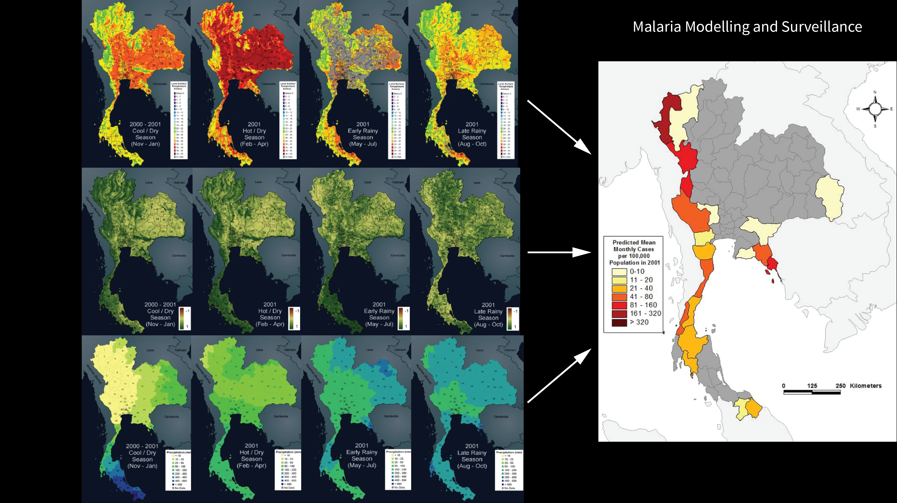
Notes:
Malaria modeling with satellite data
Despite efforts to eradicate malaria in the 1950s and 1960s, the disease has remained endemic in many tropical areas of the world. Because wide spread spraying of insecticides to control the mosquitos which spread malaria is costly and damaging to the environment, better methods of mosquito control are needed.
One approach to solving this problem involves modeling the lifecycle of the mosquitos which transmit malaria in order to predict when and where they will be most abundant. Remote sensing data, such as maps of temperature, vegetation, and rainfall are combined with models of the moquito's lifcycle in order to predict where the mosquitos will live and breed. Insecticide and other treatments can then be targeted those times and areas when they will have the most effect.
For more information:
appliedsciences.nasa.gov/programs/health-air-quality-program

