Slide 1
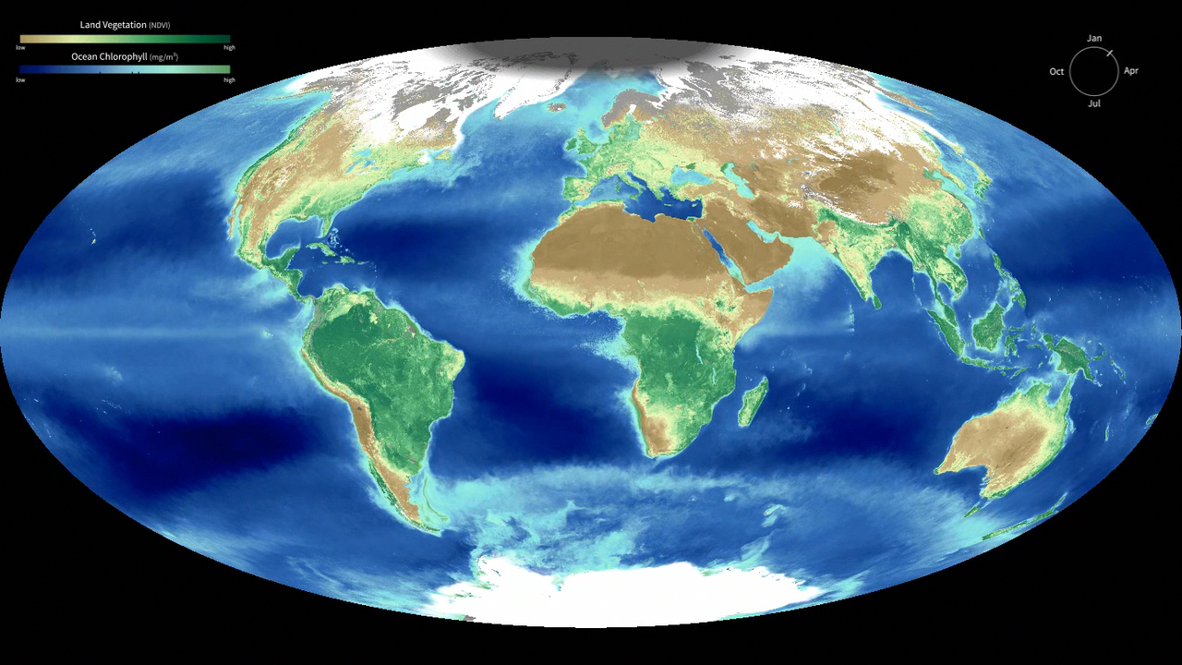
Notes:
Biosphere Yearly Cycle
Satellite instruments reveal the yearly cycle of plant life on the land and in the water. On land, the images represent the density of plant growth, while in the oceans they show the chlorophyll concentration from tiny, plant-like organisms called phytoplankton. From December to February, during the northern hemisphere winter, plant life in the higher latitudes is minimal. The region shaded dark gray shows areas receiving no sunlight, and snow and ice cover much of those areas. However even in the mid latitudes plants are dormant, shown here with browns and yellows on the land and dark to mid blues in the ocean. By contrast the southern ocean and land masses are at the height of the summer season and plant life is revealed with dark green colors on the land and bright teal in the ocean. As the year progresses, the situations reverses, with plant life following the increased sunlight northward, while the southern hemisphere experiences decreased plant actvity during its' winter.
These images are generated by combining data from many satellite instruments and averaging them over a period of nearly 10 years.

