Slide 1
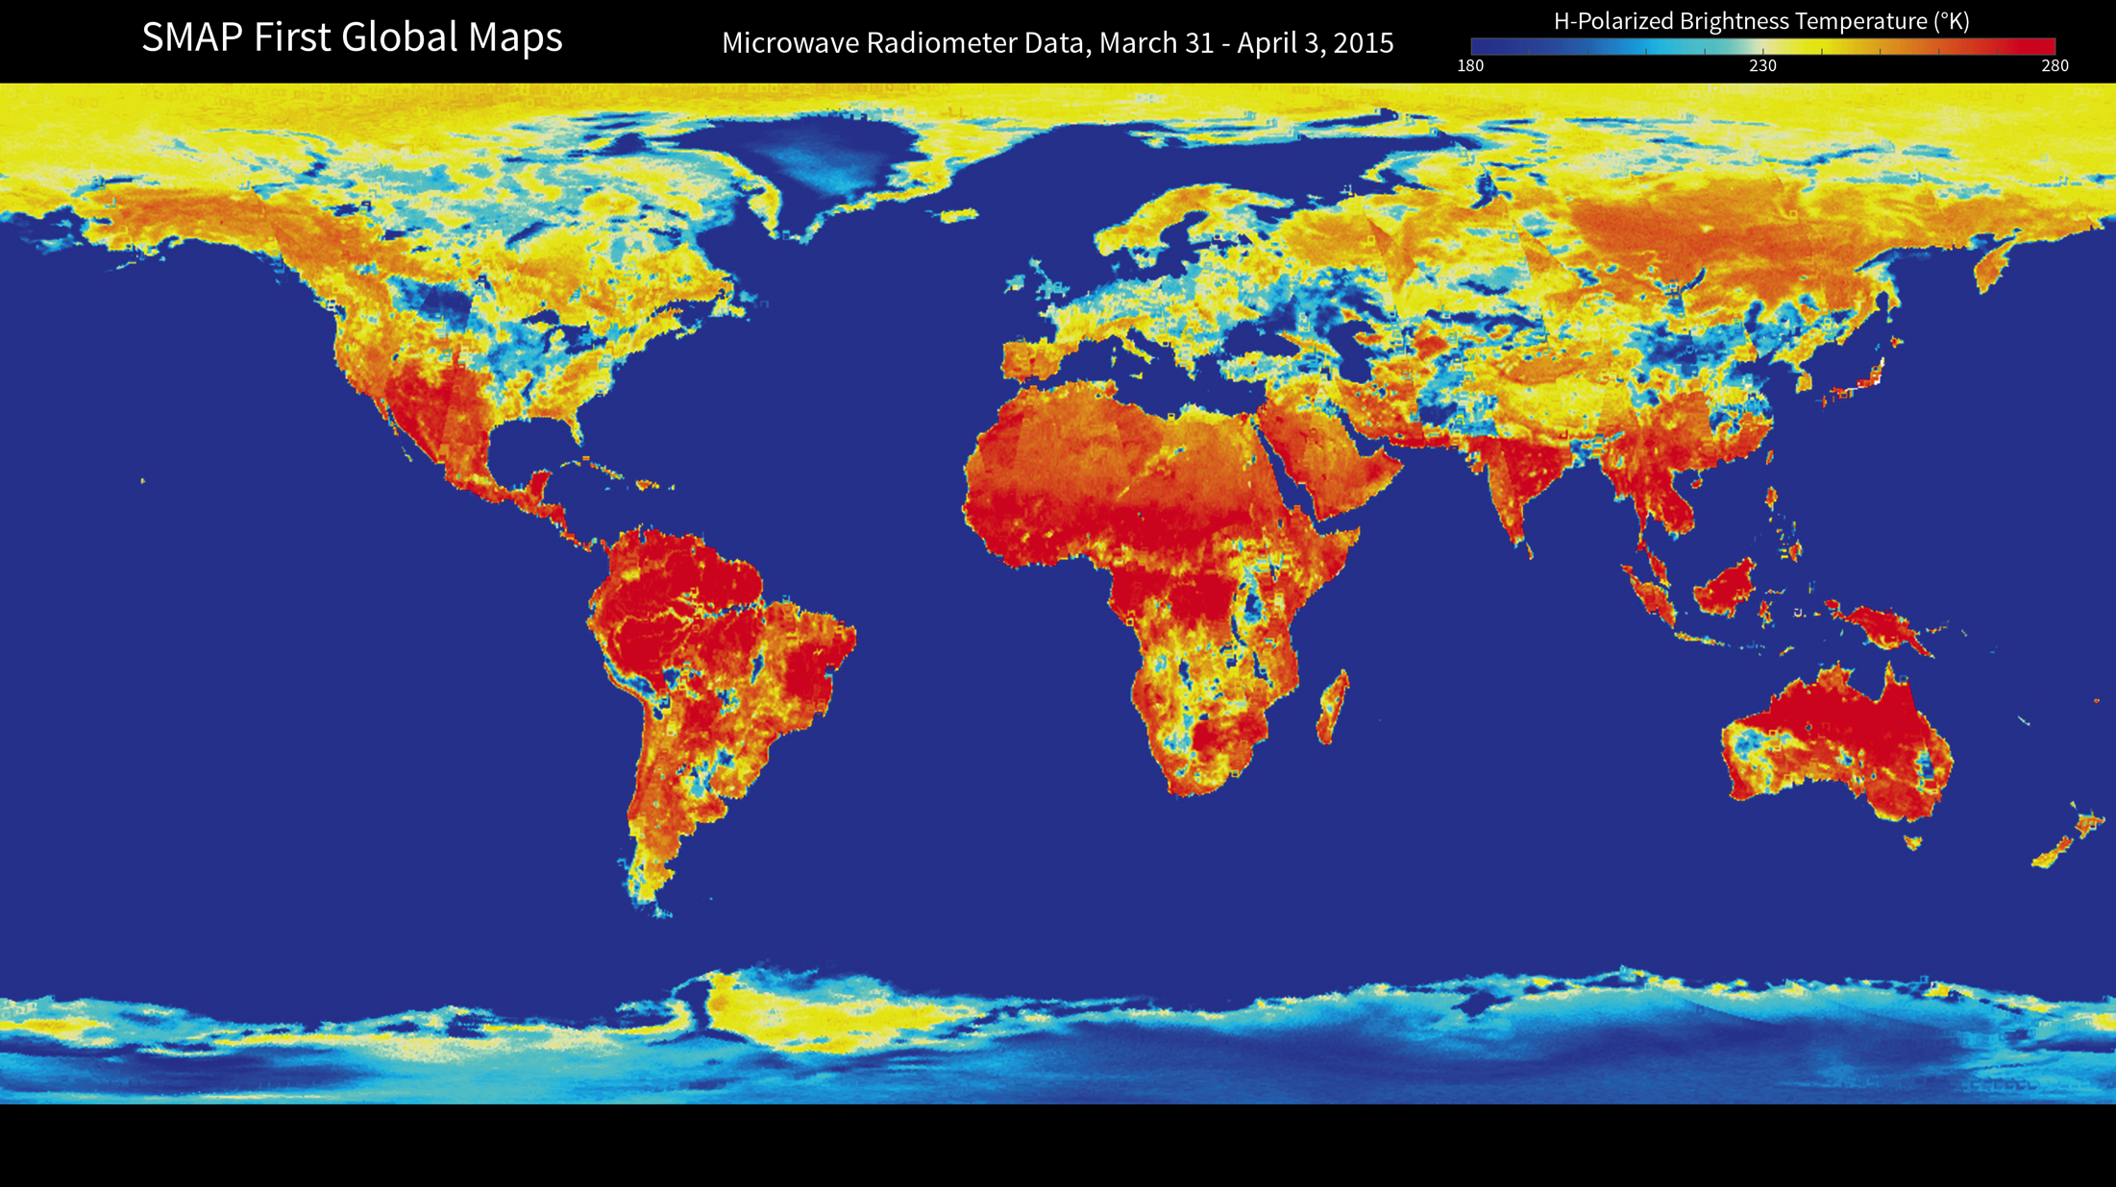
Notes:
SMAP global radiometer map
With its antenna now spinning at full speed, NASA's new Soil Moisture Active Passive (SMAP) observatory has successfully re-tesed its science instruments and generated its first global maps. This image is the first global map from SMAP's microwave radiomter, which detects differences in microwave emissions caused by water in soil.
Around the globe, the most striking difference in these natural emissions is between water and land surfaces. A desert emits mirowaves at about three times the rate a lake does. Because the difference is so large, even a small amount of moisture in soil causes a change that a radiometer can measure accurately. The Amazon and Congo rainforests produced strong emissions, depicted in red shades, due to their large volumes of biomass. Brightness temperatures in the Sahara Desert reach about 80 degrees Fahrenhit (about 300 Kelvin) due to its low moisture content. The impact of soil moisture is evident over a large region south of the reat Lakes, where an increase in soil moisture due to precipitation in March resulted in relatively cool brightness temperature of about minus 100 Fahrenheit (about 200 Kelvin). Similar impacts of rain on soil moistures and brightness temperatures are sen in Namibia and Botswana, Africa, where there was significant rainfall in late March.
The radiometer brightness temperatures of Earth's ocean are mostly below minus 172 Fahrenheit (160 Kelvin), which is below the ower end of the color table in this image. The brightness temperatures of Greenland and Antarctica are low (approximately 200 Klvin) due to their low physical temperatures and high emissivity (the efficiency of these polar regions at emitting thermal enegy). The brightness temperatures of sea ice fall in the middle range because its salt content is less than the salty water in the ocean, but high enough to distinguish it from land surfaces.
http://www.jpl.nasa.gov/news/news.php?feature=4560

