Slide 1
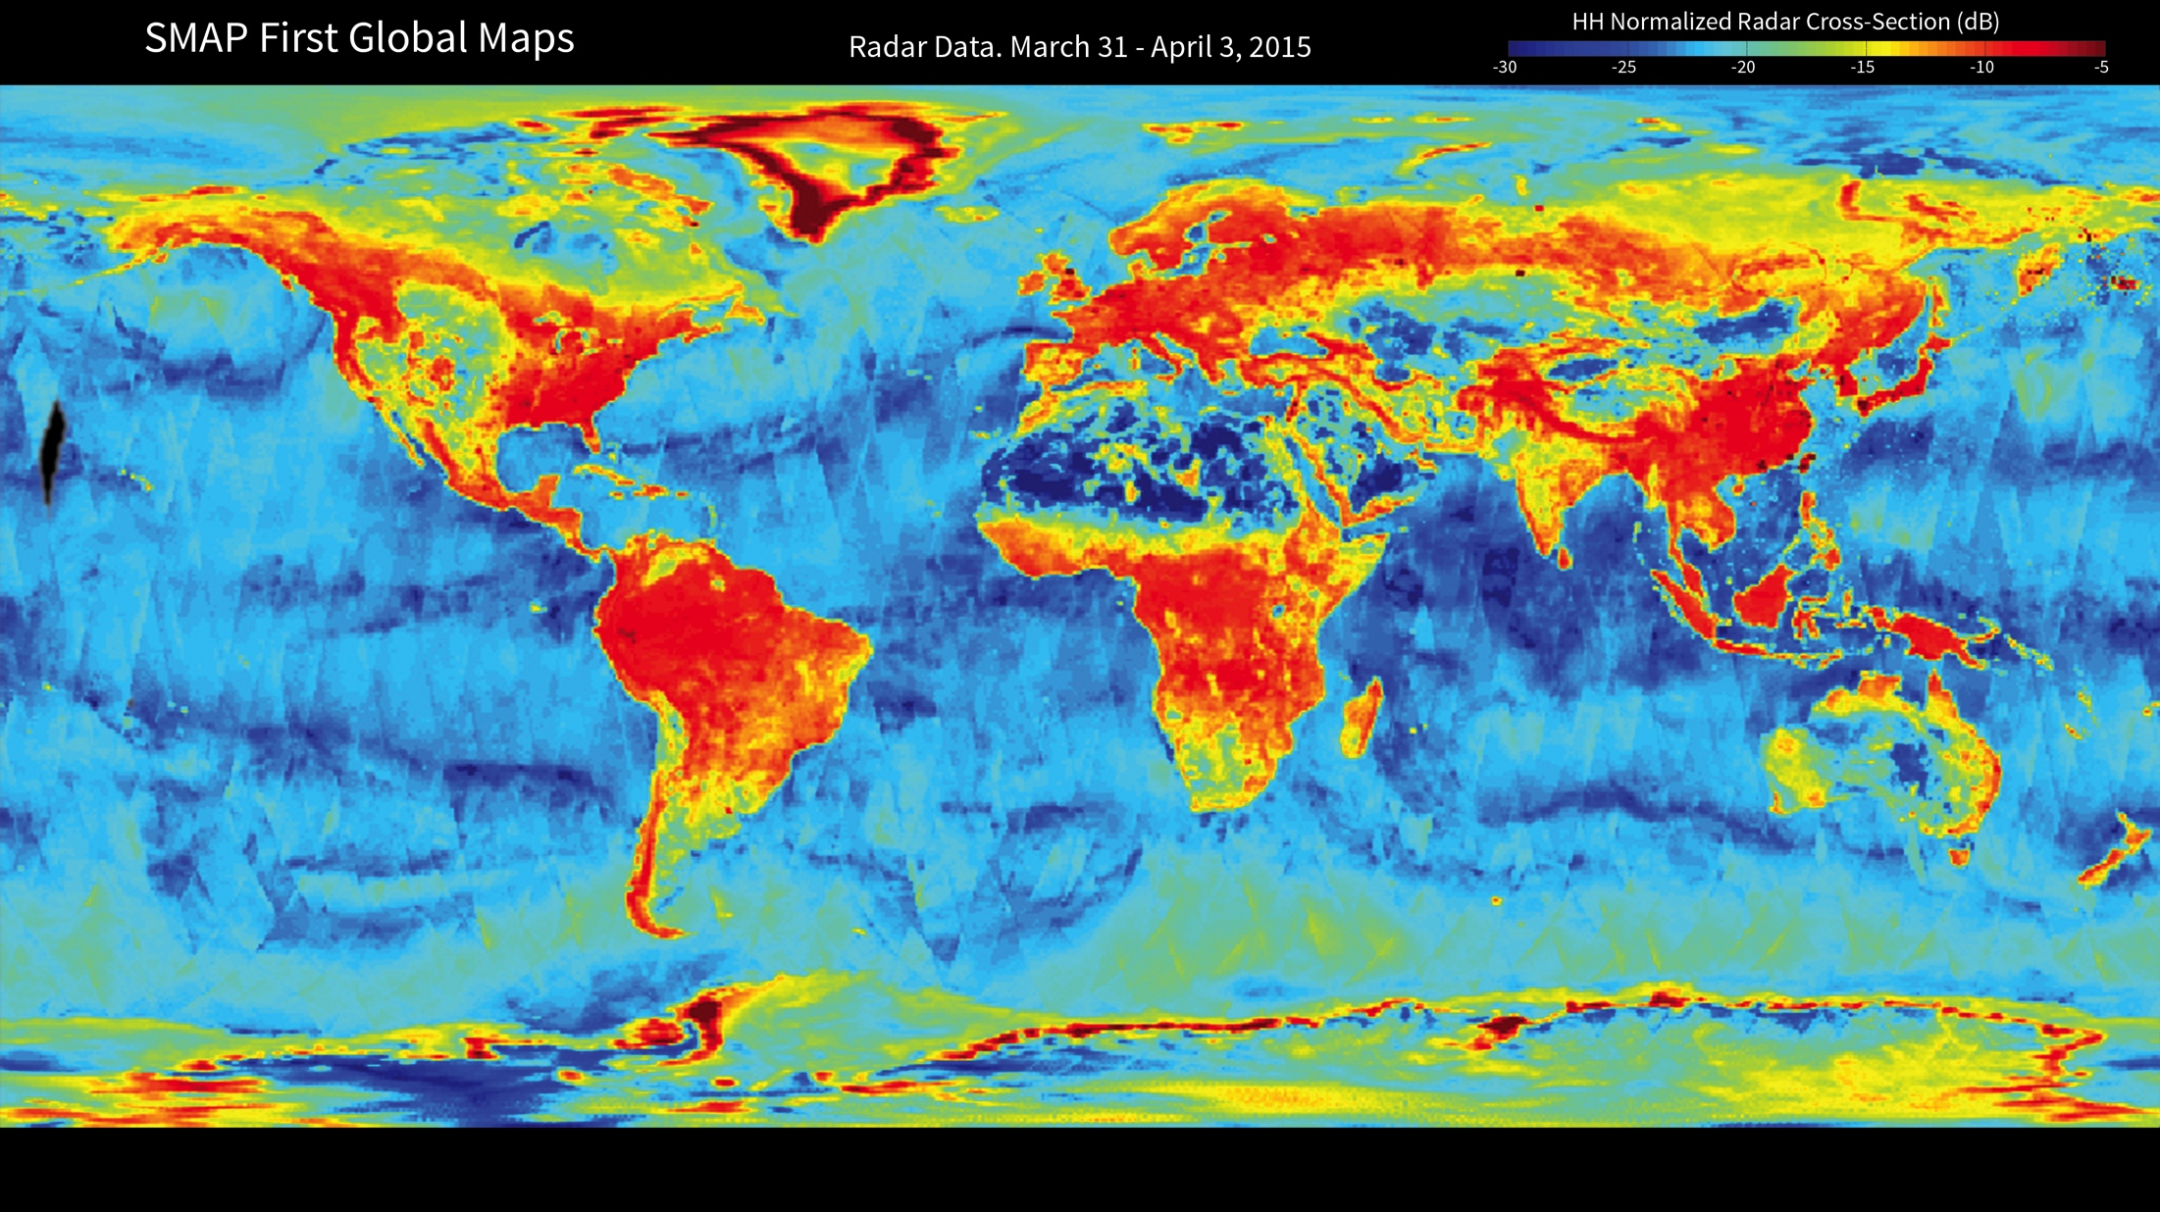
Notes:
SMAP global radar map
With its antenna now spinning at full speed, NASA's new Soil Moisture Active Passive (SMAP) observatory has successfully re-tested its science instruments and generated its first global maps. This image is the first global map from SMAP's radar, which detects differences in the strength and polarization of microwave backscatter (or reflection) caused by water in soil.
Backscatter from soil containing more moisture is stronger and is polarized differently than backscatter from drier soil. The extent of this difference allows scientists to distinguish the amount of moisture present in the soil.
In the composite radar image, global land, ocean and ice conditions are readily apparent. The weaker radar signals measured over the Sahara and Gobi Deserts, depicted in blue shades, indicate their very low soil moisture content and lack of vegetation cover. In contrast, the densely vegetated Amazon and Congo rain forests have very strong radar signals, depicted in reds. In North America, the boreal forests and tree canopies in the Rockies, Sierra Nevada and Cascade mountain ranges, and areas east of the Mississippi River, also have strong radar echoes. Grasslands and prairies in the U.S. Great Plains, a great expanse of flat land, exhibit relatively lower-strength radar echoes.
http://www.jpl.nasa.gov/news/news.php?feature=4560

