Slide 1
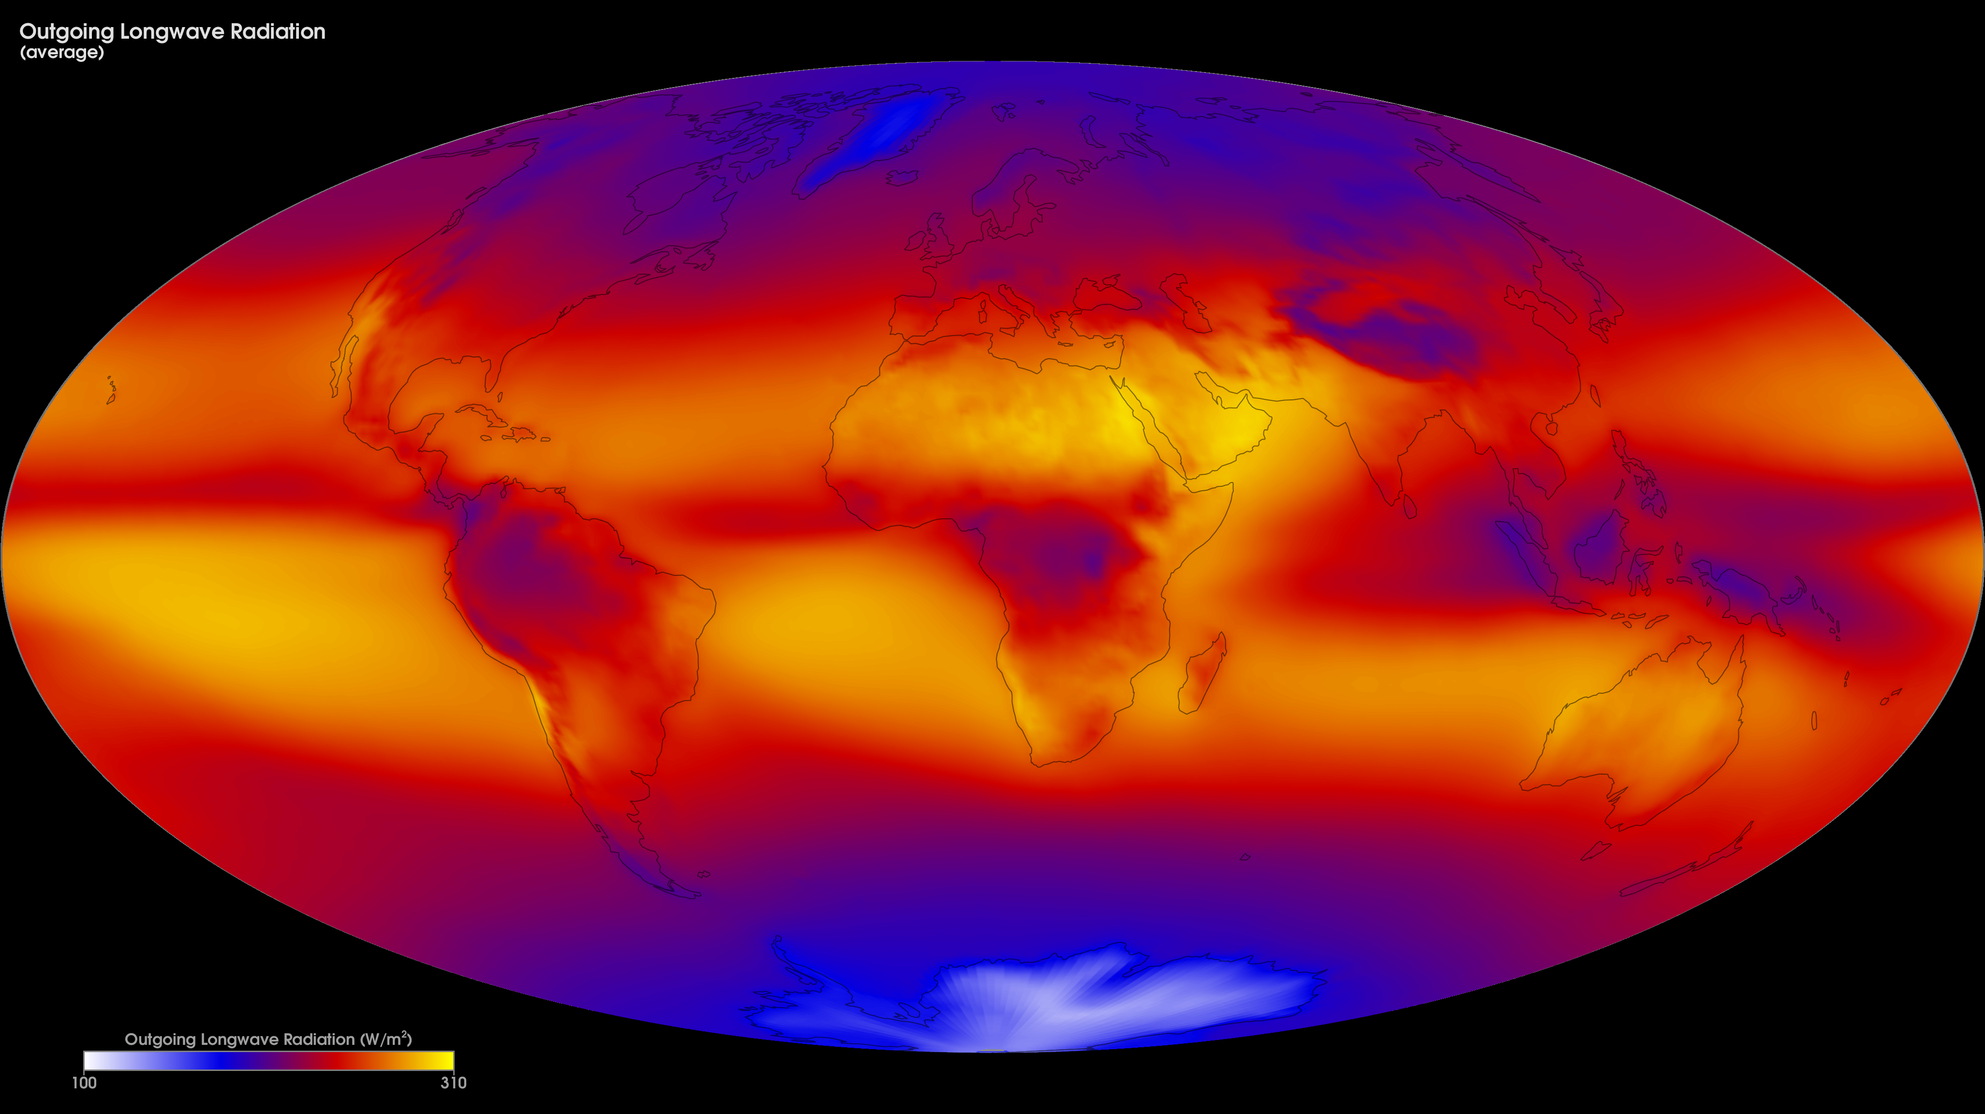
Notes:
Average Outgoing Longwave Radiation
Light energy travels in waves, but not all the waves are the same. The kind of light our eyes can see is only a tiny part of the energy that exists in the universe. Other kinds of energy are invisible, like the energy that makes our hands feel warm when we hold them over a fire, or the energy that cooks our food in the microwave. When Earth absorbs sunlight, it heats up. The heat, or "outgoing longwave radiation," radiates back into space. Satellites measure this radiation as it leaves the top of Earth's atmosphere. The hotter a place is, the more energy it radiates.
This map shows monthly outgoing longwave radiation averaged over the years 2000-2015 from the Energy Balanced and Filled (EBAF) data product. This data is produced by averaging observations collected by the Clouds and the Earth's Radiant Energy System (CERES) sensors on NASA's Aqua and Terra satellites, filling in gaps and constraining the fluxes to remove the inconsistency between average global net TOA flux and heat storage in the Earth-atmosphere system.
The colors show the amount of outgoing longwave radiation leaving Earth's atmosphere (in Watts per square meter). Bright yellow and orange indicate greater heat emission, purple and blue indicate intermediate emissions, and white shows little or no heat emission.
For more information:
ceres.larc.nasa.gov

