Slide 1
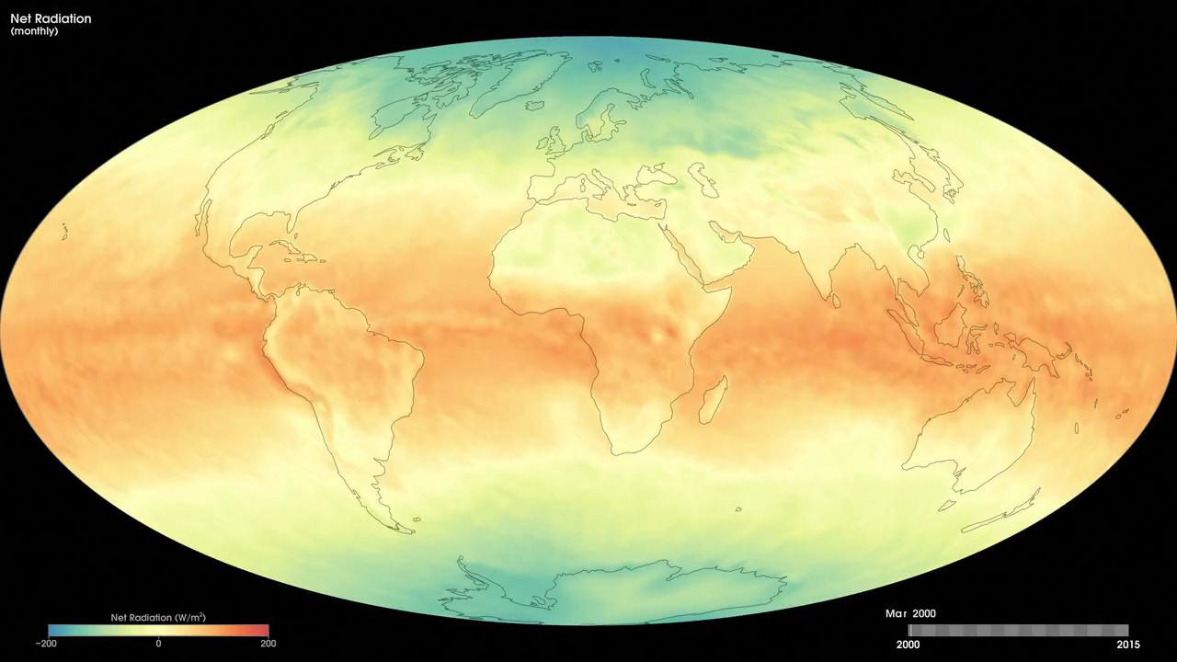
Notes:
Monthly Net Radiation
The difference between how much solar energy enters the Earth system and how much heat energy escapes into space is called <i>net radiation</i>. Some places absorb more energy than they give off back to space, so they have an energy surplus. Other places lose more energy to space than they absorb, so they have an energy deficit.
These maps show monthly net radiation from March 2000 to the present from the Energy Balanced and Filled (EBAF) data product. This data is produced by averaging observations collected by the Clouds and the Earth's Radiant Energy System (CERES) sensors on NASA's Aqua and Terra satellites, filling in gaps and constraining the fluxes to remove the inconsistency between average global net TOA flux and heat storage in the Earth-atmosphere system.
The colors show the net radiation (in Watts per square meter) that was contained in the Earth system. The maps illustrate the fundamental imbalance between net radiation surpluses at the equator (green areas), where sunlight is direct year-round, and net radiation deficits at high latitudes (blue areas), where direct sunlight is seasonal.
For more information:
neo.sci.gsfc.nasa.gov/Search.html?datasetId=CERES_NETFLUX_M

