Slide 1
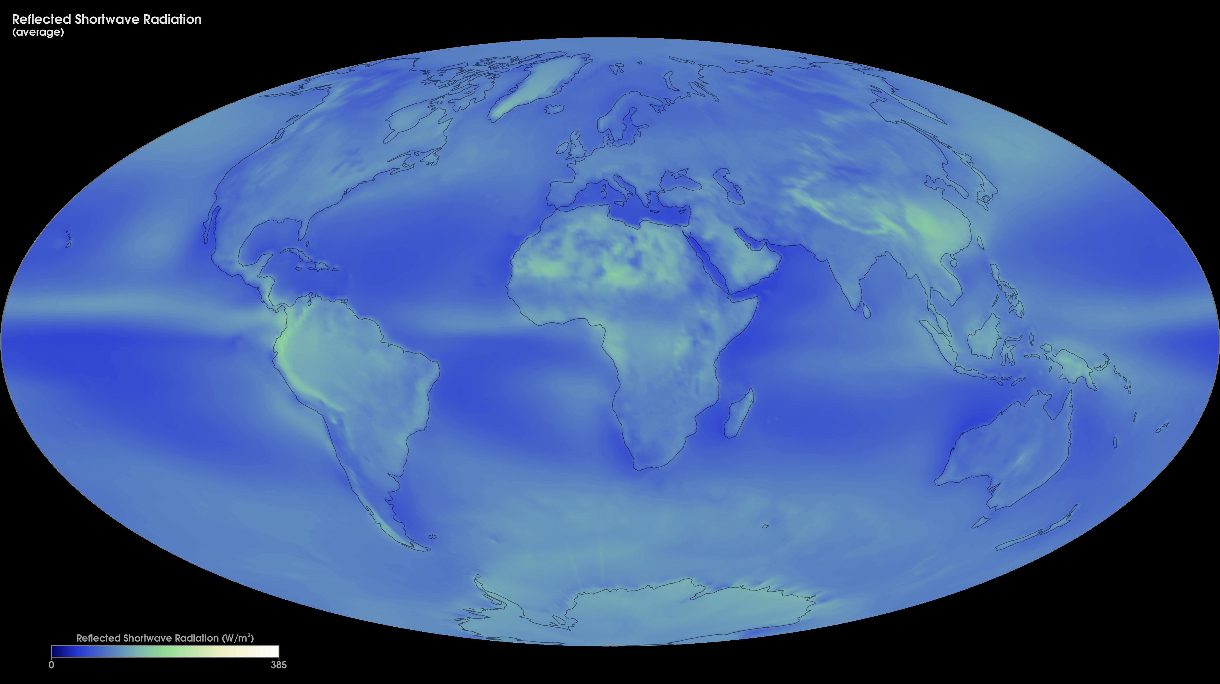
Notes:
Average Monthly Reflected-Shortwave Radiation
If you look at Mars in the night sky, the planet is little more than a glowing dot. From Mars, Earth would have the same star-like appearance. What gives the planets this light? Do they shine like a star? No. The light is mostly reflected sunlight. These images show how much sunlight Earth reflects. Bright parts of Earth like snow, ice, and clouds, reflect the most light; dark surfaces, like the oceans, reflect less light. Earth's average temperature is determined by the balance between how much sunlight Earth reflects, how much it absorbs, and how much heat it gives off.
This map shows monthly reflected-shortwave radiation averaged over the years 2000-2015 from the Energy Balanced and Filled (EBAF) data product. This data is produced by averaging observations collected by the Clouds and the Earth's Radiant Energy System (CERES) sensors on NASA's Aqua and Terra satellites, filling in gaps and constraining the fluxes to remove the inconsistency between average global net TOA flux and heat storage in the Earth-atmosphere system.
The colors in the map show the amount of shortwave energy (in Watts per square meter) that was reflected by the Earth system. The brighter, whiter regions show where more sunlight is reflected, while green regions show intermediate values, and blue regions are lower values.
For more information:
neo.sci.gsfc.nasa.gov/Search.html?datasetId=CERES_SWFLUX_M

