Slide 1
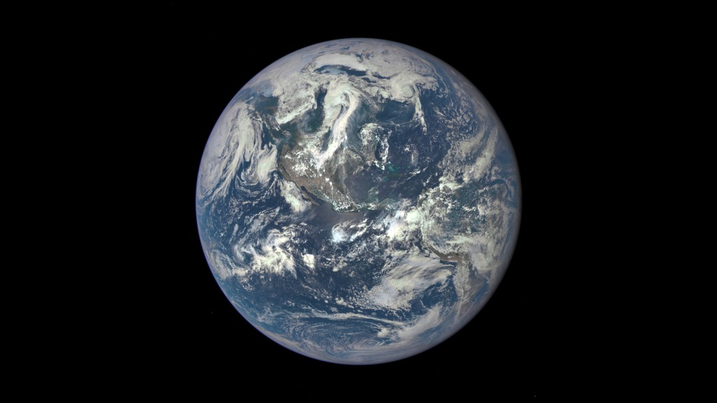
Notes:
Africa and Europe from a Million Miles Away
Africa is front and center in this image of Earth taken by a NASA camera on the Deep Space Climate Observatory (DSCOVR) satellite. The image, taken July 6, 2015, from a vantage point one million miles from Earth, was one of the first taken by DSCOVR’s Earth Polychromatic Imaging Camera (EPIC).
Central Europe is toward the top of the image with the Sahara Desert to the south, showing the Nile River flowing to the Mediterranean Sea through Egypt. The photographic-quality color image was generated by combining three separate images of the entire Earth taken a few minutes apart. The camera takes a series of 10 images using different narrowband filters—from ultraviolet to near infrared—to produce a variety of science products. The red, green, and blue channel images are used in these Earth images.
The DSCOVR mission is a partnership between NASA, the National Oceanic and Atmospheric Administration (NOAA), and the U.S. Air Force, with the primary objective to maintain the nation’s real-time solar wind monitoring capabilities. Data from EPIC will also be used to measure ozone and aerosol levels in Earth’s atmosphere, cloud height, vegetation properties and a variety of other features.
For more information, see:
go.nasa.gov/1H2onyP

