Slide 1
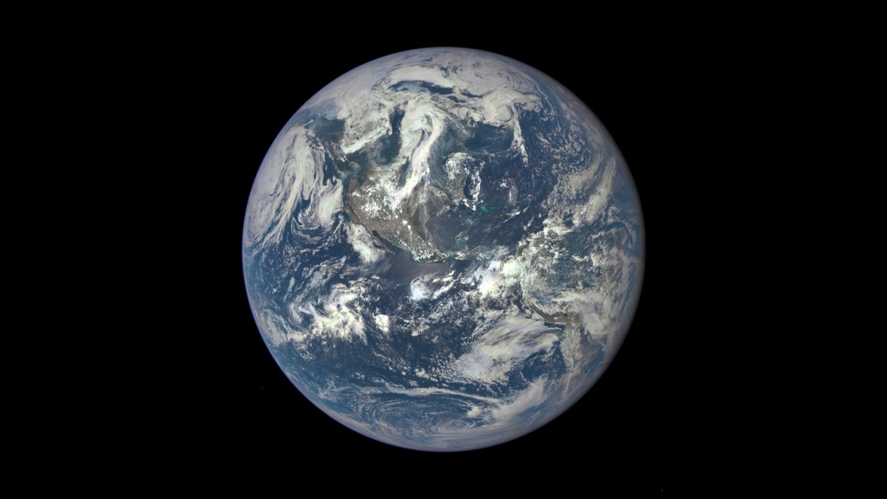
Notes:
EPIC View of Earth
On July 6, 2015, a NASA camera onboard the Deep Space Climate Observatory (DSCOVR) satellite returned its first view of the entire sunlit side of Earth from its orbit at the first Lagrange point (L1), about one million miles from Earth. This initial image, taken by DSCOVR’s Earth Polychromatic Imaging Camera (EPIC), shows the effects of sunlight scattered by air molecules, giving the image a characteristic bluish tint. Once the instrument begins regular data acquisition, images will be available every day, 12 to 36 hours after they are acquired by EPIC. Data from EPIC will be used to measure ozone and aerosol levels in Earth’s atmosphere, cloud height, vegetation properties, and the ultraviolet reflectivity of Earth. NASA will use these data for a number of Earth science applications, including dust and volcanic ash maps of the entire planet.
The primary objective of DSCOVR, a partnership between NASA, the National Oceanic and Atmospheric Administration (NOAA), and the U.S. Air Force, is to maintain the nation’s real-time solar wind monitoring capabilities, which are critical to the accuracy and lead time of space weather alerts and forecasts from NOAA.
For more information, see:
go.nasa.gov/1MDczYR

