Slide 1
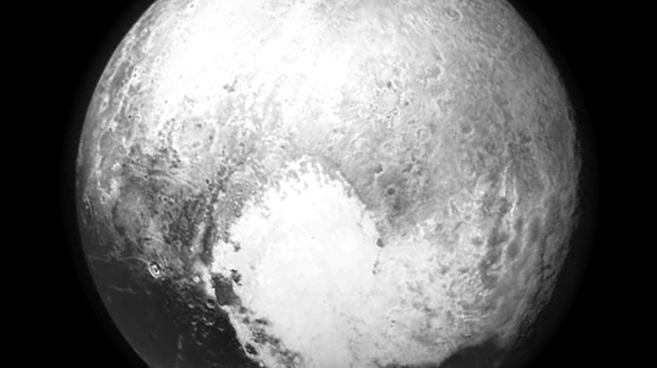
Notes:
Pluto before New Horizons Encounter
Pluto nearly fills the frame in this image from the Long Range Reconnaissance Imager (LORRI) aboard NASA's New Horizons spacecraft, taken on July 13, 2015, when the spacecraft was 476,000 miles (768,000 kilometers) from the surface. This is the last and most detailed image sent to Earth before the spacecraft's closest approach to Pluto on July 14.
For more information, see:
pluto.jhuapl.edu/soc/Pluto-Encounter/index.php

