Slide 1
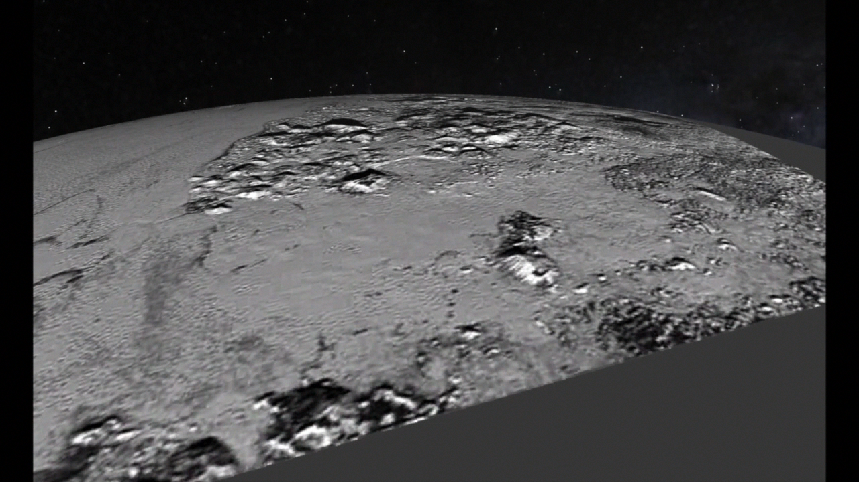
Notes:
Fly through Pluto's Mountains
This simulated flyover of Pluto's Norgay Montes (Norgay Mountains) and Sputnik Planum (Sputnik Plain) was created from New Horizons closest-approach images. Norgay Montes have been informally named for Tenzing Norgay, one of the first two humans to reach the summit of Mount Everest. Sputnik Planum is informally named for Earth's first artificial satellite. The images were acquired by the Long Range Reconnaissance Imager (LORRI) on July 14 from a distance of 48,000 miles (77,000 kilometers). Features as small as a half-mile (1 kilometer) across are visible.
For more information, see:
http://pluto.jhuapl.edu

