Slide 1
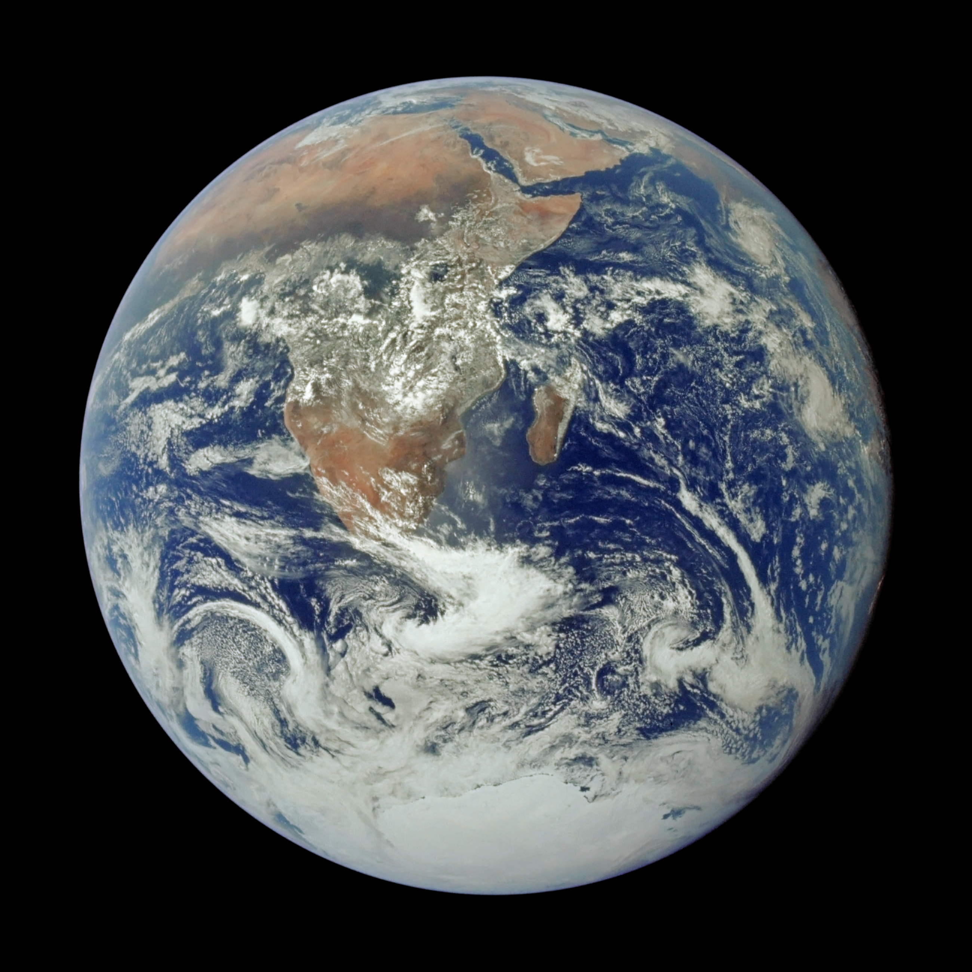
Notes:
The Blue Marble From Apollo 17
This classic photograph of the Earth was taken on December 7, 1972, as seen by the Apollo 17 crew traveling toward the moon. Often referred to as the ‘Blue Marble,’ the photo extends from the Mediterranean Sea area to the Antarctica south polar ice cap. This is the first time the Apollo trajectory made it possible to photograph the south polar ice cap. Almost the entire coastline of Africa is clearly visible. The Arabian Peninsula can be seen at the northeastern edge of Africa. The large island off the coast of Africa is the Malagasy Republic. The Asian mainland is on the horizon toward the northeast.
For more information, visit:
www.nasa.gov/apollo

