Slide 1
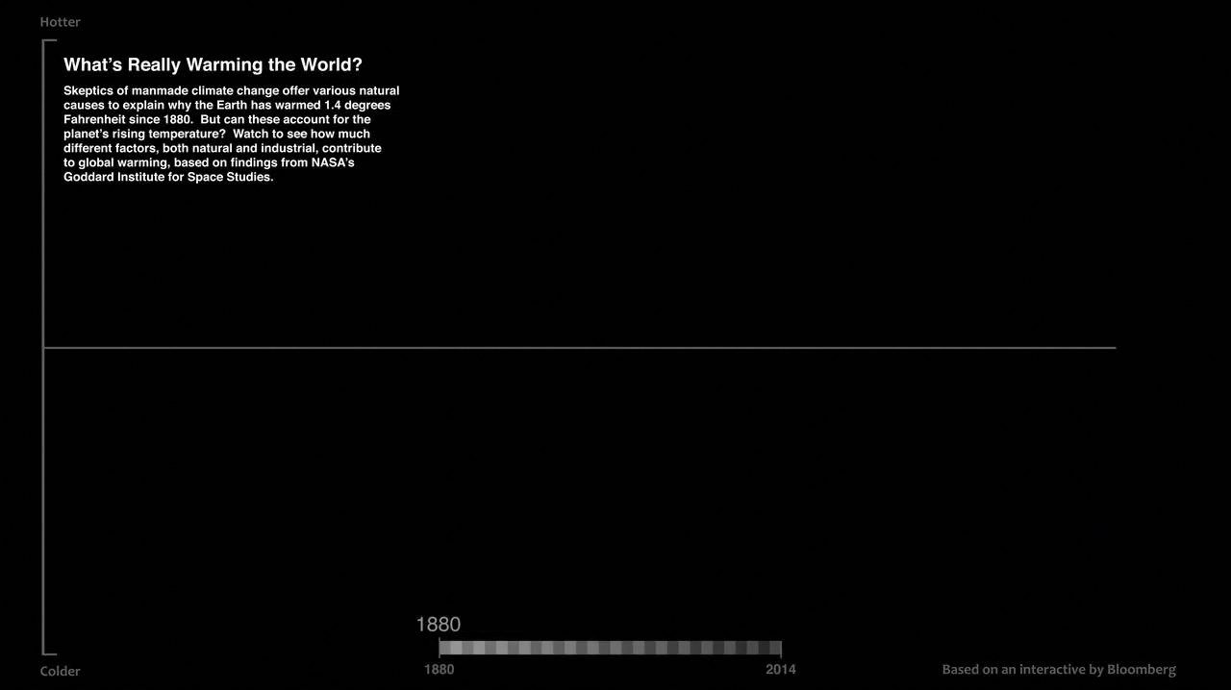
Notes:
How Global Warming Stacks Up
Skeptics of manmade climate change offer various natural causes to explain why the
Earth has warmed 1.4 degrees Fahrenheit since 1880. But can these account for the
planet’s rising temperature? Watch to see how much different factors, both natural and industrial, contribute to global warming, based on findings from NASA’s Goddard Institute for Space Studies.
For more information, visit:
svs.gsfc.nasa.gov/goto?30615

