Slide 1
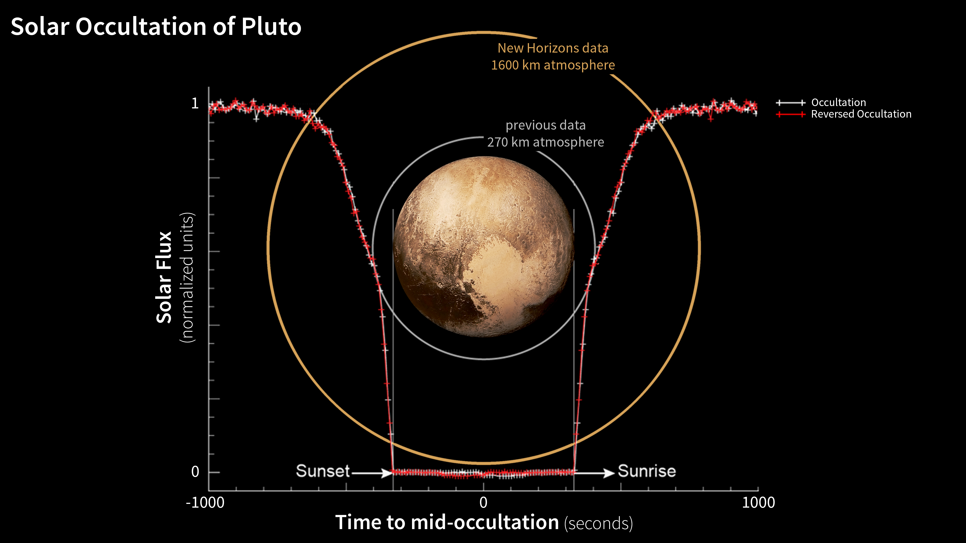
Notes:
Pluto's Extended Atmosphere
Scientists working with NASA's New Horizons spacecraft have observed Pluto's atmosphere as far as 1,000 miles (1,600 kilometers) above the surface of the planet, demonstrating that Pluto's nitrogen-rich atmosphere is quite extended. This is the first observation of Pluto's atmosphere at altitudes higher than 170 miles above the planet's surface (270 kilometers).
The new information was gathered by New Horizons' Alice imaging spectrograph during a carefully designed alignment of the sun, Pluto, and the spacecraft starting about an hour after the craft's closest approach to the planet on July 14. During the event known as a solar occultation, New Horizons passed through Pluto's shadow while the sun backlit Pluto's atmosphere.
For mre information, see:
pluto.jhuapl.edu

