Slide 1
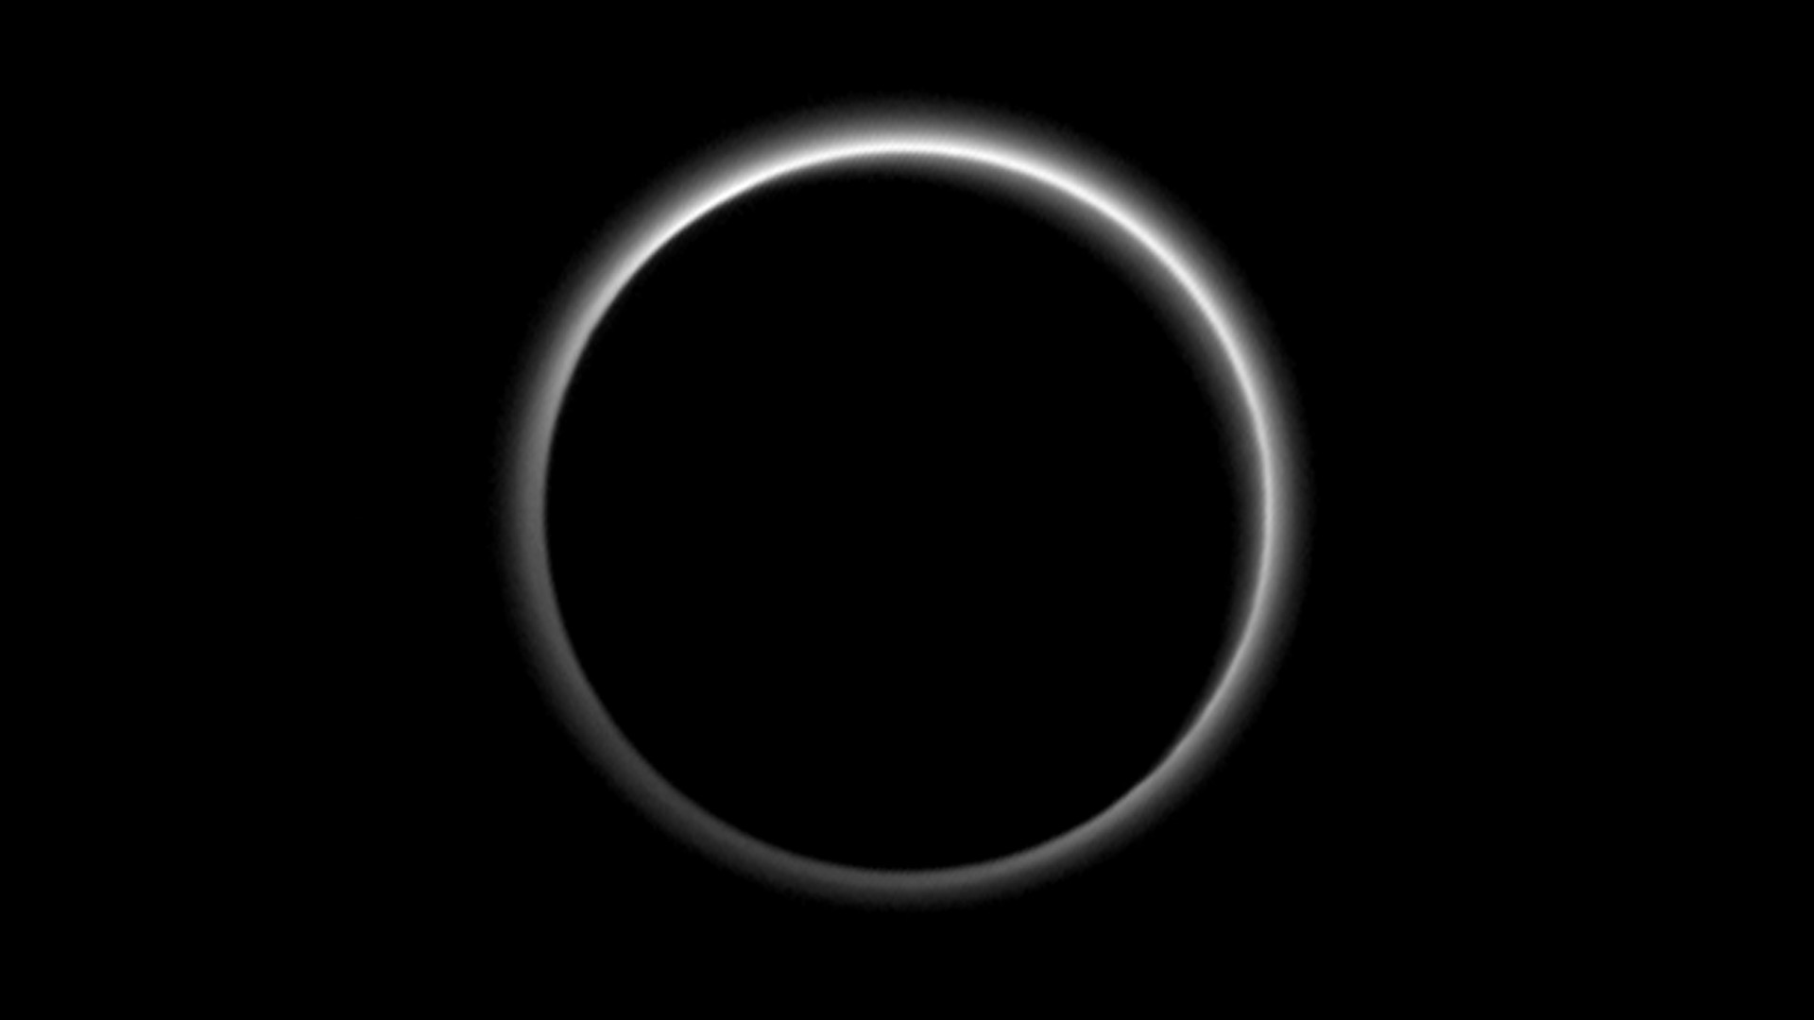
Notes:
Haze Surrounds Pluto
Just seven hours after its closest approach, NASA's New Horizons spacecraft aimed its Long Range Reconnaissance Imager (LORRI) back at Pluto, capturing sunlight streaming through the atmosphere and revealing haze as high as 80 miles (130 kilometers) above Pluto's surface. A preliminary analysis of the image shows two distinct layers of haze—one about 50 miles (80 kilometers) above the surface and the other at an altitude of about 30 miles (50 kilometers).
For more information, see:
pluto.jhuapl.edu

