Slide 1
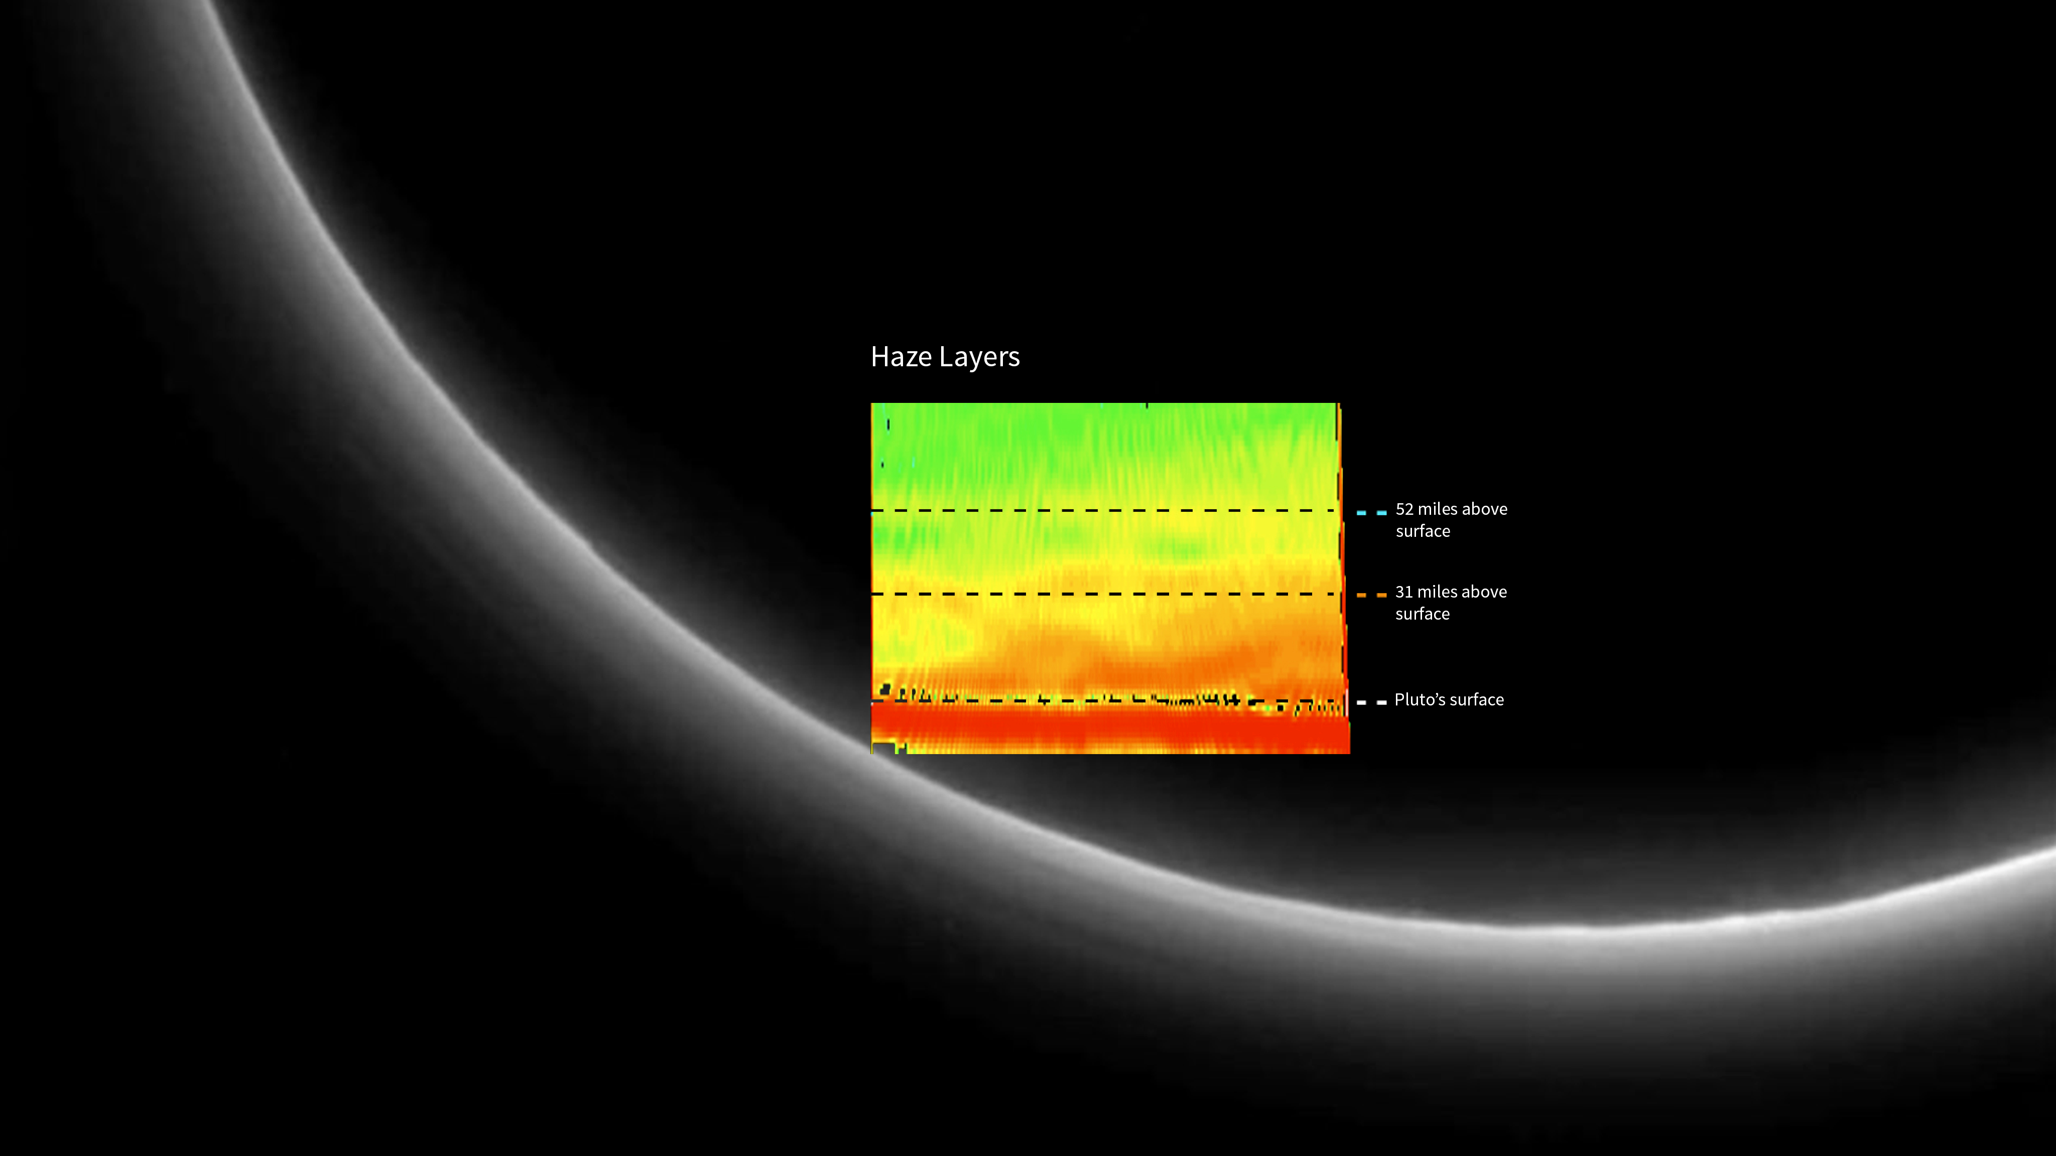
Notes:
Pluto's Haze Layers
Image of Pluto's haze layers. A false-color inset reveals a variety of structures, including two distinct layers.
For more information, see:
pluto.jhuapl.edu

