Slide 1
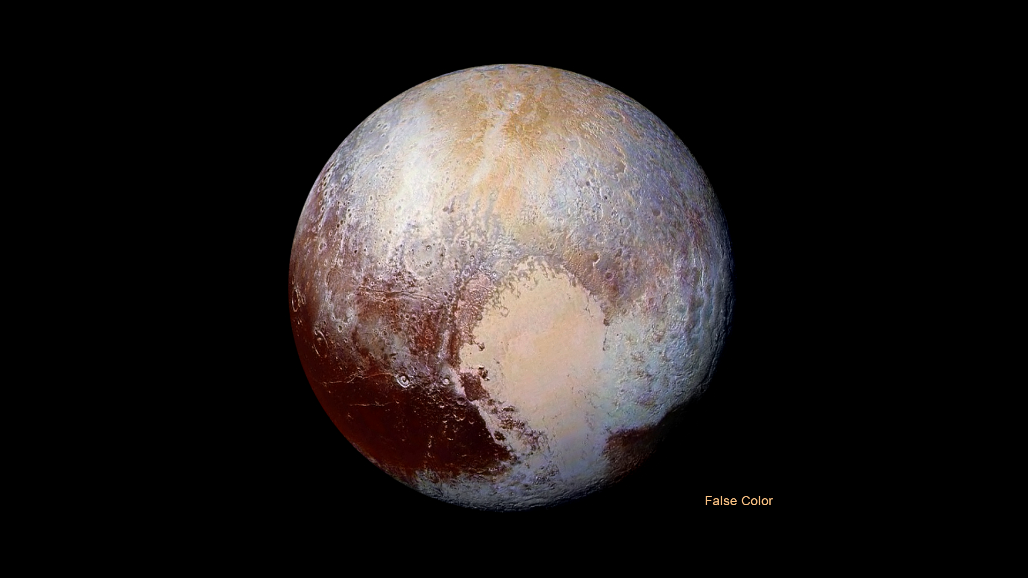
Notes:
False-Color Image of Pluto
Four images from New Horizons' Long Range Reconnaissance Imager (LORRI) were combined with color data from the Ralph instrument to create this enhanced color global view of Pluto. (The lower right edge of Pluto in this view currently lacks high-resolution color coverage.) The images, taken when the spacecraft was 280,000 miles (450,000 kilometers) away, show features as small as 1.4 miles (2.2 kilometers).
For more information, see:
pluto.jhuapl.edu

