Slide 1
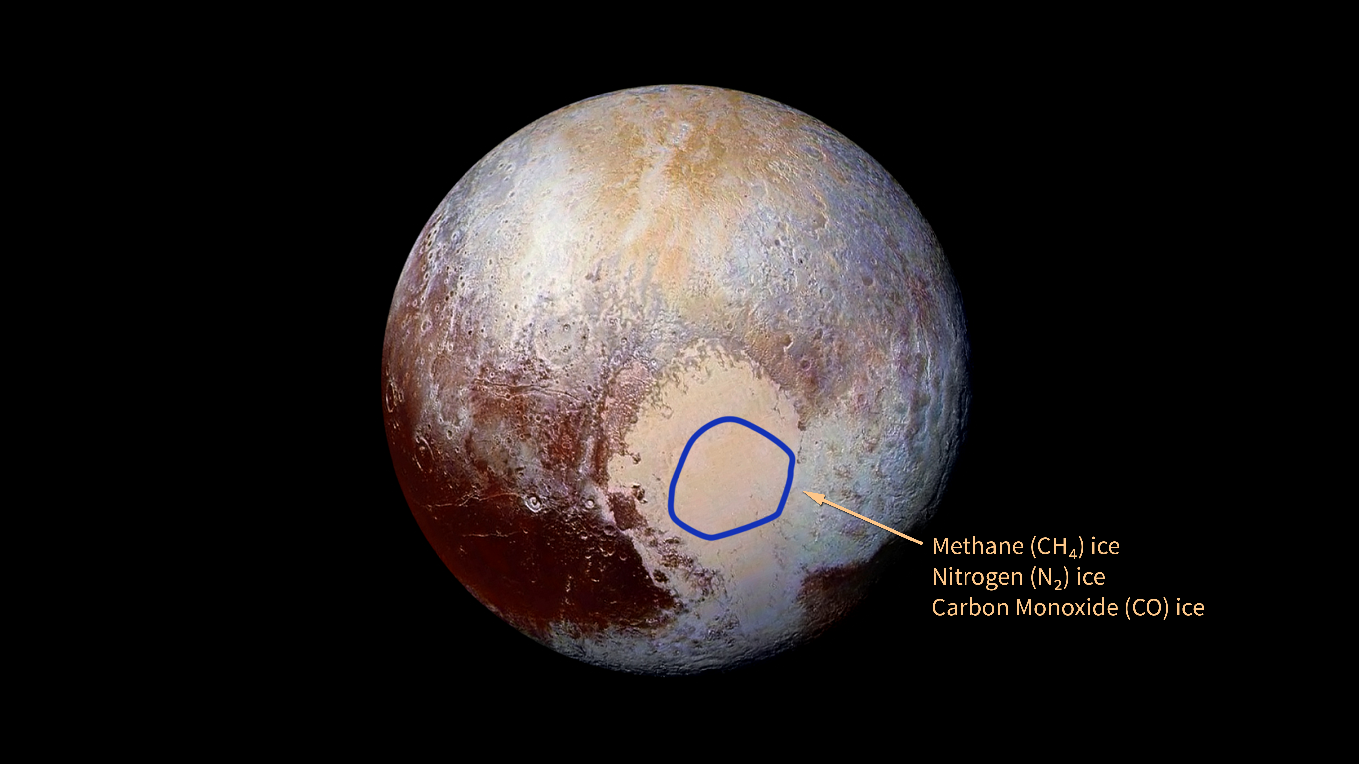
Notes:
New Horizons Discovers Ice on Pluto
Images from New Horizons’ Long Range Reconnaissance Imager (LORRI) were combined with color data from the Ralph instrument to create this enhanced color global view of Pluto. Within the circled region of Pluto's Sputnik Planum, New Horizons’ Ralph instrument has detected frozen methane, nitrogen, and carbon monoxide. “At Pluto’s temperatures of minus-390 degrees Fahrenheit, these ices can flow like a glacier,” said Bill McKinnon, of Washington University in St. Louis, deputy leader of the New Horizons Geology, Geophysics and Imaging team.
For more information, see:
pluto.jhuapl.edu

