Slide 1
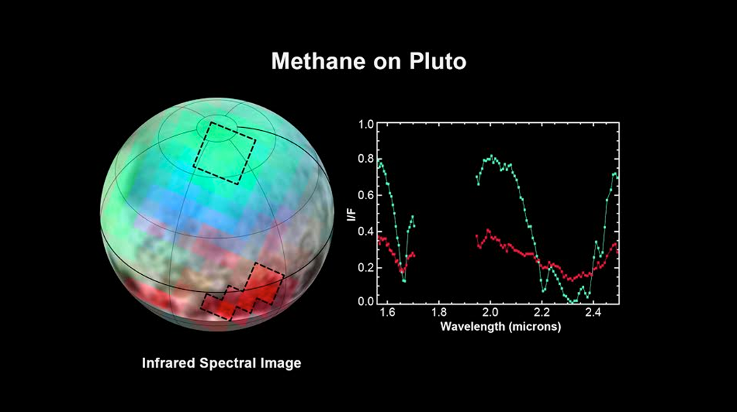
Notes:
Pluto: The Ice Plot Thickens
The latest spectra from New Horizons' Ralph instrument reveal an abundance of methane ice, but with striking differences from place to place across the frozen surface of Pluto.
"We just learned that in the north polar cap, methane ice is diluted in a thick, transparent slab of nitrogen ice resulting in strong absorption of infrared light, said New Horizons co-investigator Will Grundy, Lowell Observatory, Flagstaff, Arizona. In one of the visually dark equatorial patches, the methane ice has shallower infrared absorptions indicative of a very different texture. "The spectrum appears as if the ice is less diluted in nitrogen," Grundy speculated or that it has a different texture in that area."
An Earthly example of different textures of a frozen substance: a fluffy bank of clean snow is bright white, but compacted polar ice looks blue. New Horizons' surface composition team, led by Grundy, has begun the intricate process of analyzing Ralph data to determine the detailed compositions of the distinct regions on Pluto.
This is the first detailed image of Pluto from the Linear Etalon Imaging Spectral Array, part of the Ralph instrument on New Horizons. In this picture, blue corresponds to light of wavelengths 1.62 to 1.70 micrometers, a channel covering a medium-strong absorption band of methane ice, green (1.97 to 2.05 micrometers) represents a channel where methane ice does not absorb light, and red (2.30 to 2.33 micrometers) is a channel where the light is very heavily absorbed by methane ice. The two areas outlined on Pluto show where Ralph observations obtained the spectral traces at the right. Note that the methane absorptions (notable dips) in the spectrum from the northern region are much deeper than the dips in the spectrum from the dark patch. The Ralph data were obtained by New Horizons on July 12, 2015.
For more inforamtion, see:
pluto.jhuapl.edu

