Slide 1
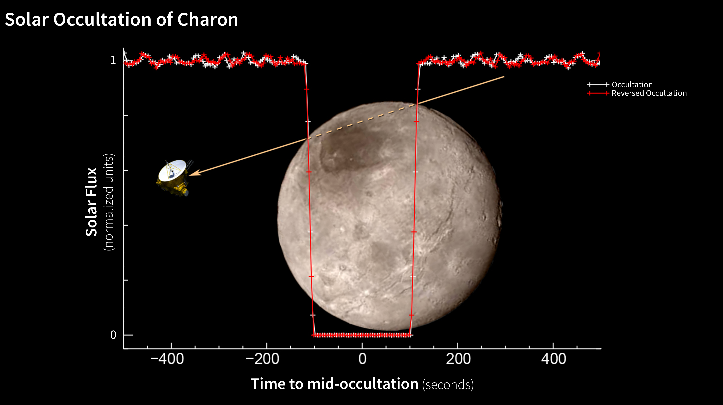
Notes:
Charon Solar Occultation
Searching for signs of an atmosphere around Pluto's largest moon Charon, New Horizons' Alice instrument observed Charon passing in front of the sun—an event called an occultation—on July 14, 2015. Only a portion of the occultation data have been transmitted to Earth so far; in that limited dataset, an atmosphere has not yet been detected.
For more information, see:
pluto.jhuapl.edu

