Slide 1
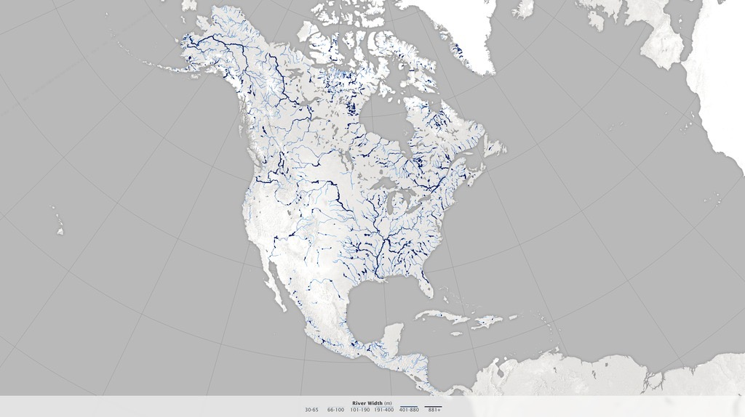
Notes:
A Satellite View of River Width
Hydrologists from the University of North Carolina have come up with an innovative way to estimate the size of rivers via satellite images. Combing through data acquired by Landsat satellites, George Allen and Tamlin Pavelsky have compiled a new database of river widths for North America. The database was created from a collection of 1,756 Landsat images with minimal cloud cover and rivers free of ice cover. To minimize the influence of seasonal changes, all images were selected for times when each river had its annual average discharge. Allen and Pavelsky then ran all of the images through a software program that automatically locates the centerline and edges of a river.
The result is this continental-scale map of river widths. Width is depicted with shades of blue, with wider rivers appearing darker and thinner rivers appearing lighter. According to this data set, some of the widest stretches of river in North America are found along the Yukon in Alaska, the Mackenzie in Canada’s Northwest Territories, the Hudson in New York, the St. Lawrence along the border of New England and Quebec, and the Mississippi. Note that having a wide width does not necessarily correspond to having a large flow volume.
Accurate river widths are useful for analyses of flood hazards, studies of ecological diversity, and estimates of the volume of greenhouse gases released by rivers and reservoirs due to bacterial activity. Most significantly, the river width database is part of a broader scientific effort to prepare for the upcoming Surface Water and Ocean Topography (SWOT) mission. The satellite—a collaboration between NASA and France’s Centre National d‘Etudes Spatiales—is scheduled to launch in 2020. It will map water elevation and areal extent with unprecedented detail.
For more information, visit
earthobservatory.nasa.gov/IOTD/view.php?id=86172

