Slide 1
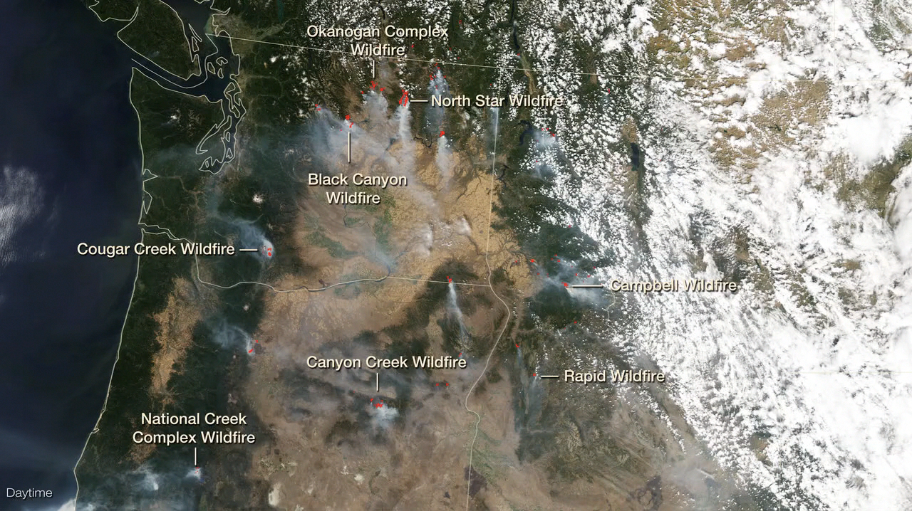
Notes:
Fires at Night in the U.S. Northwest
In summer 2015, wildfires raged across the western United States and Alaska. Many of those fires burned in the U.S. Northwest, visible in these images from late August. The nighttime image was acquired during early morning hours on August 19 by the Visible Infrared Imaging Radiometer Suite (VIIRS) sensor on the Suomi National Polar-orbiting Partnership satellite. The image was made possible by the instrument’s “day-night band,” which uses filtering techniques to observe dim signals including those from wildfires. The daytime image shows the same area in natural-color, acquired by the Moderate Resolution Imaging Spectroradiometer (MODIS) on NASA’s Aqua satellite during the afternoon of August 18. Red outlines indicate hot spots where the sensor detected unusually warm surface temperatures generally associated with fires. Thick plumes of smoke are visible emanating from the hot spots.
According to the Northwest Interagency Coordination Center, the Okanogan Complex Fire in Washington was among the larger active fires. On August 20, the fire had burned 91,314 acres (143 square miles). In Oregon, the Canyon Creek Complex Fire had burned 48,201 acres (75 square miles), destroyed 26 residences, and threatened another 500. Both fires were less than 40% contained. Meanwhile, firefighters had made progress on the large, damaging Cornet-Windy Ridge Fire in Oregon, which on August 20 was 70% contained.
For more information, visit
earthobservatory.nasa.gov/IOTD/view.php?id=86458

