Slide 1
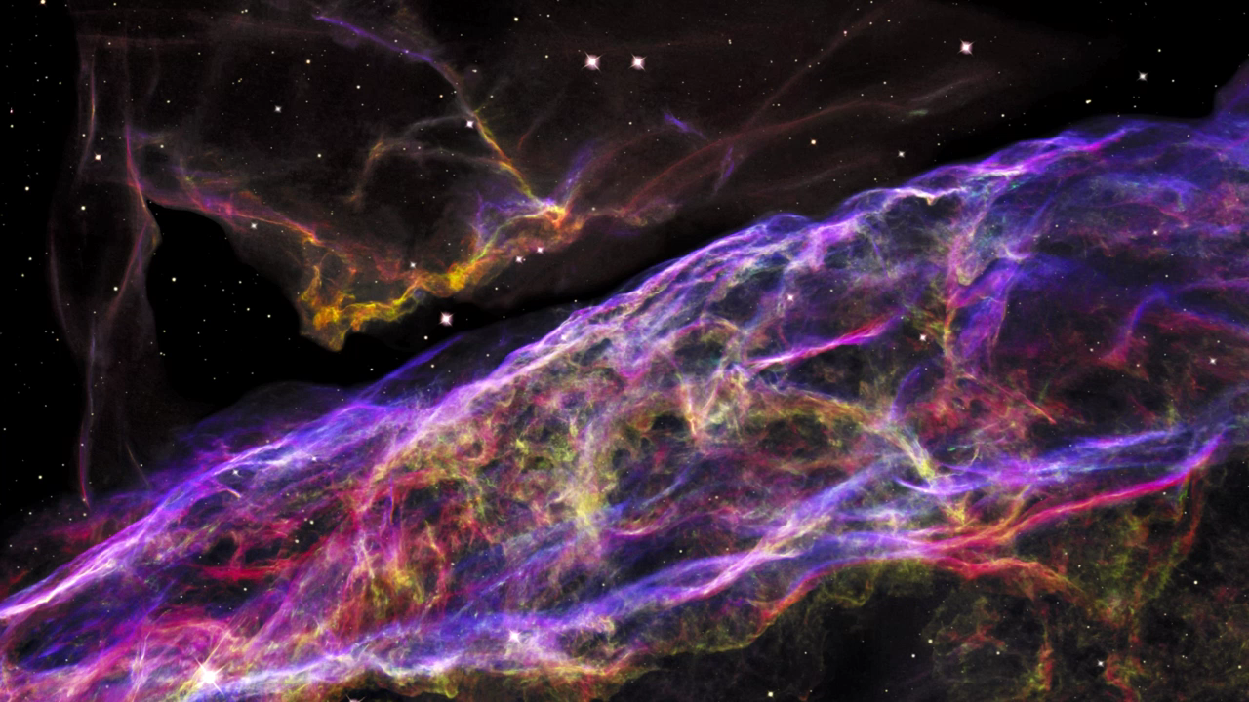
Notes:
The Veil Supernova Remnant
This 3-D visualization flies across a small portion of the Veil Nebula as photographed by the Hubble Space Telescope. This region is a small part of a huge expanding remnant from a star that exploded many thousands of years ago. Hubble resolves tangled rope-like filaments of glowing gases. The 3-D model has been created for illustrative purposes and shows that that the giant bubble of gas has a thin, rippled surface. It also highlights that the emission from different chemical elements arises from different layers of gas within the nebula. In the imagery, emission from hydrogen, sulfur, and oxygen are shown in red, green, and blue, respectively.

